Slide 1
விண்மீன் கூட்டங்கள்
The Star Groups
S. Jaya Paul, B.Sc., M.C.A.,
Senior Scientific Assistant (Retd.)
Tamilnadu Science and Technology Centre
Consultant
Trichy Astronomy Association,
Tamilnadu Astronomy and Science Society

Slide 2
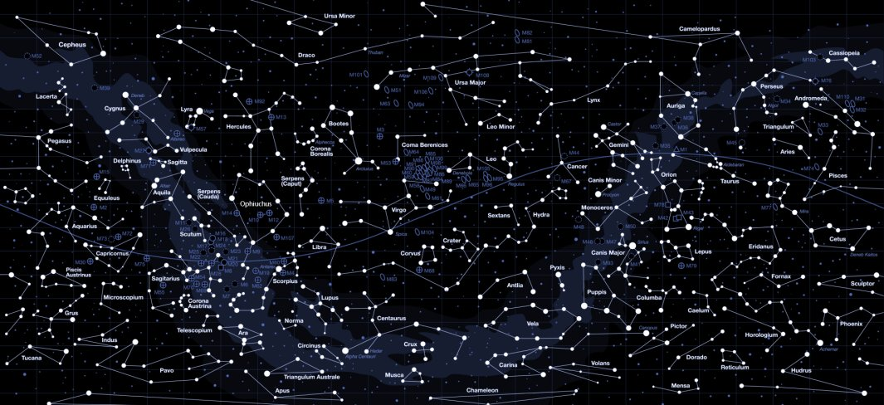
The Constellations
Constellation is a Latin word meaning “set with stars”.

Slide 3
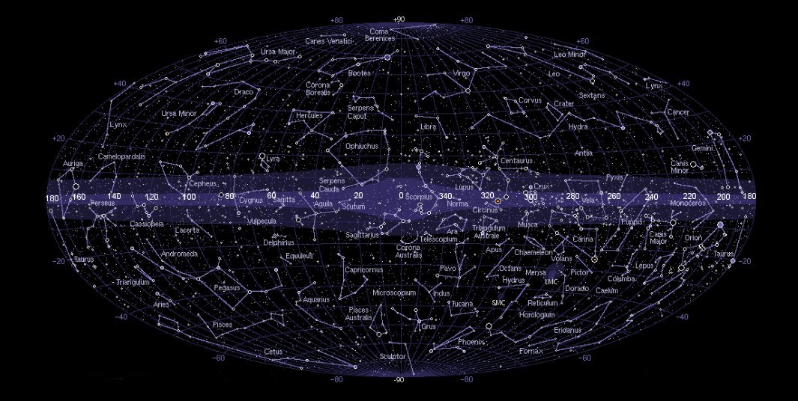
The Constellations

Slide 4
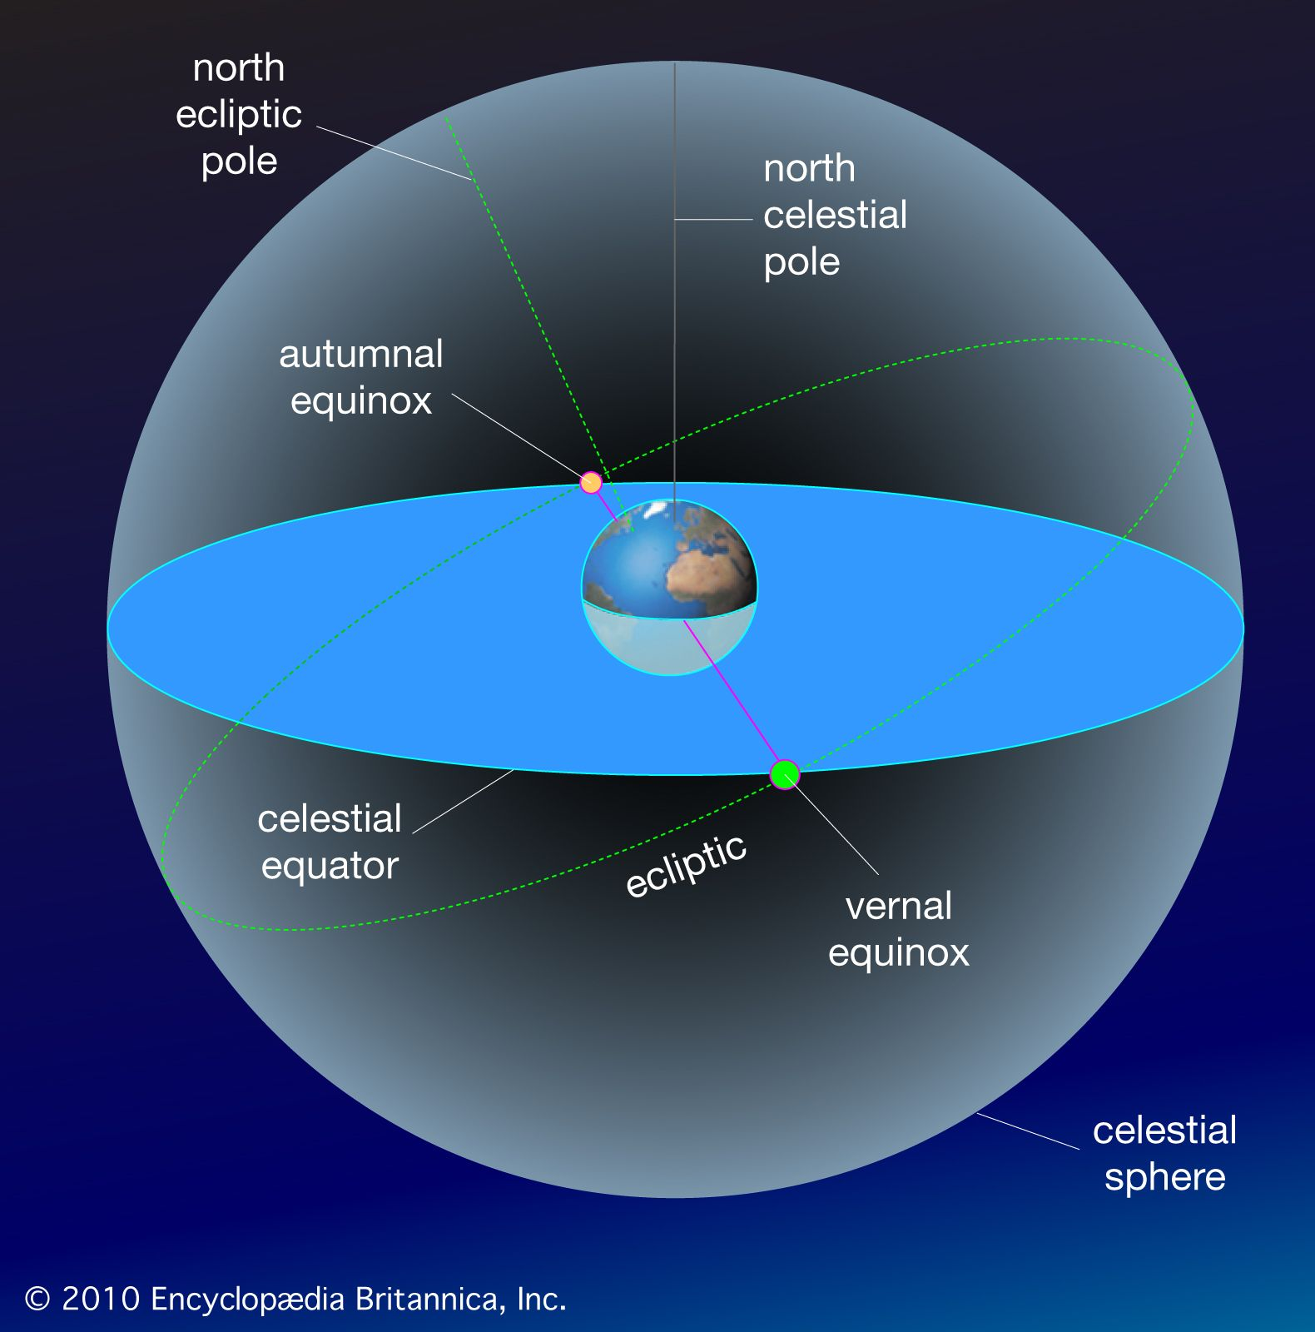
The Zodiac or Ecliptic

Slide 5
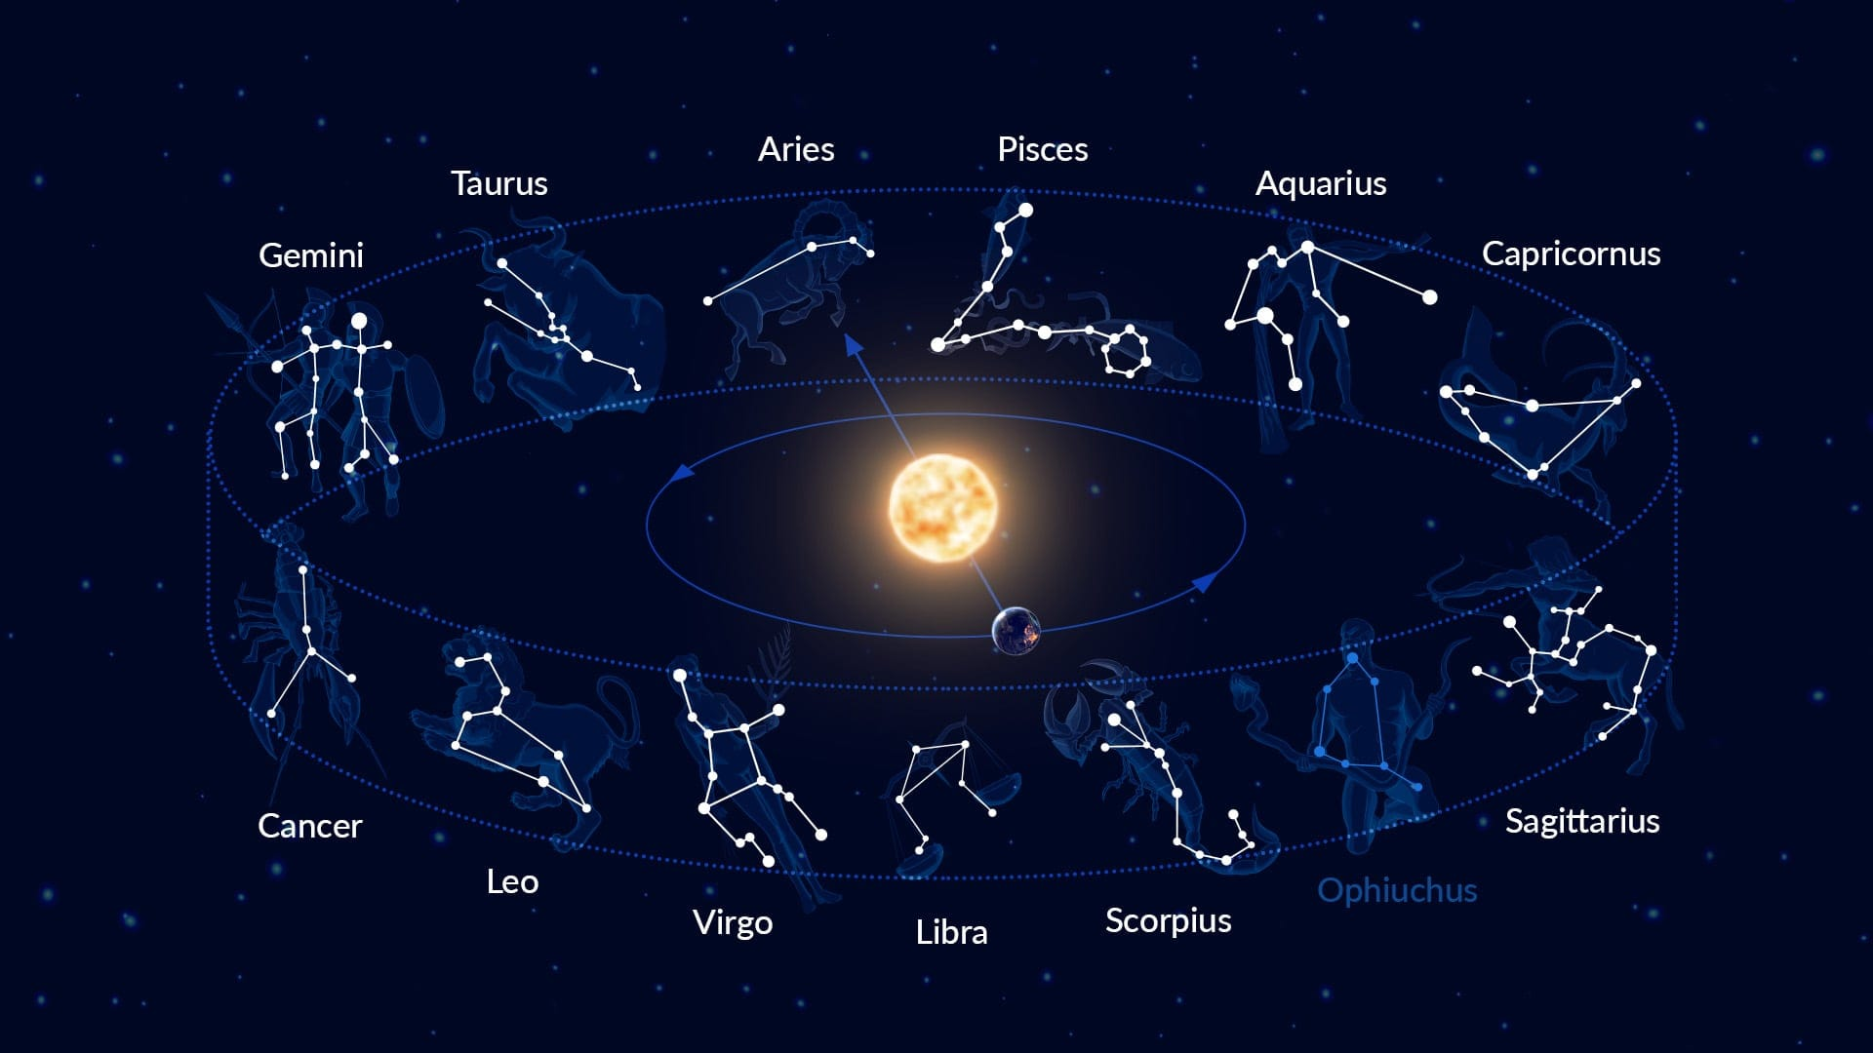
Zodiacal Constellations

Slide 6
Zodiac Constellations
The Zodiacal Constellations
The number of days the Sun spends in each zodiac constellation:
Aries (25 days), Taurus (37 days), Gemini (31 days), Cancer (20 days), Leo (37 days), Virgo (45 days), Libra (23 days), Scorpius (7 days), Ophiuchus (18 days), Sagittarius (32 days), Capricornus (23 days), Aquarius (24 days), Pisces (38 days.

Slide 7
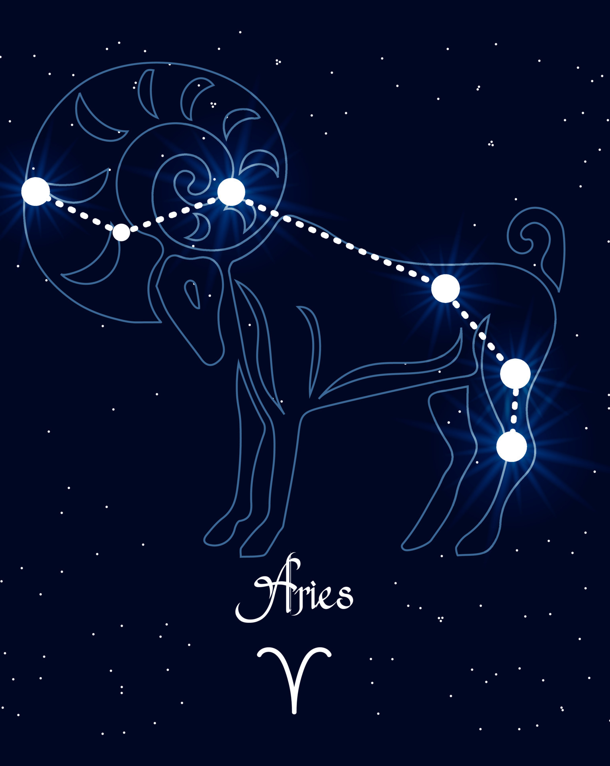
Aries
In Babylonian times Aries was tied to agriculture and hired workers.
In Greek mythology, it represents the golden ram that rescued Phrixus and Helle, inspiring the Argonauts’ quest for the Golden Fleece.
Aries was once key in marking the astrological new year and the vernal equinox.
A strong daytime Meteor Shower Arietids peaking in early June.

Slide 8
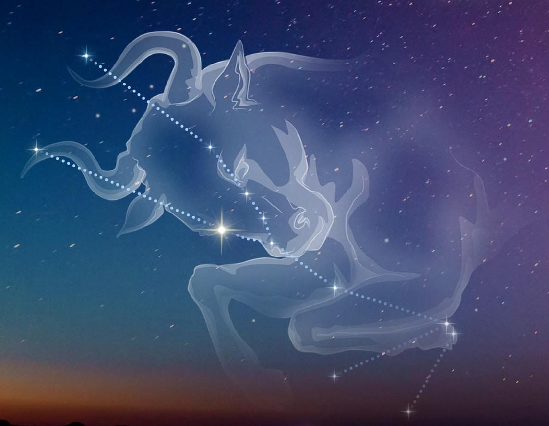
Taurus
The Pleiades star cluster, also known as the Seven Sisters, lies near Taurus’s “back” .
The Crab Nebula (M1), located in Taurus, is the remnant of a supernova explosion observed in 1054 CE, visible even during daylight.
To find Taurus, look northwest of Orion during autumn and winter in the northern hemisphere, spotting Aldebaran’s reddish glow and the distinctive V-shape of the Hyades cluster.
Taurus constellations is famous for its V-shaped Hyades cluster forming the bull’s head and the bright red giant star Aldebaran as its fiery eye.

Slide 9
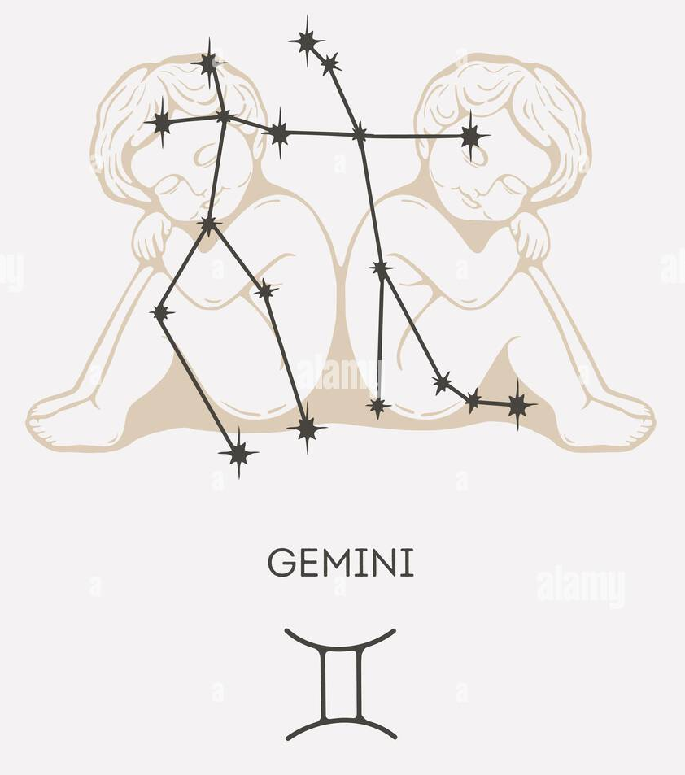
Gemini
To find Gemini in the night sky, look for two bright stars shining close together above Orion in the eastern sky during February.
In Greek mythology, Gemini represents the legendary twin brothers Castor and Pollux, symbols of duality and loyalty.
Pollux is an orange giant star, while Castor is a complex system of six stars bound together, making the constellation unique in its bright twin stars.
The constellation hosts interesting deep-sky objects like the Eskimo Nebula and the open cluster Messier 35.
Alamy

Slide 10
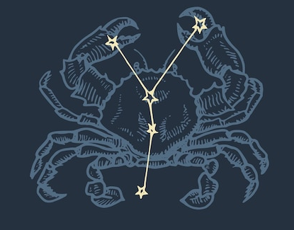
Cancer
In Greek mythology, Cancer represents the giant crab sent by Hera to distract Hercules during his battle with the Hydra; the crab was crushed but immortalized in the sky for its bravery.
Cancer is famous for containing the Beehive Cluster (M44), a stunning open star cluster visible to the naked eye as a misty patch.
Binoculars will reveal the famous Beehive Cluster near its center.
To find Cancer, look for a faint inverted “Y” shape of stars in the March night sky, nestled between the brighter constellations Gemini and Leo.

Slide 11
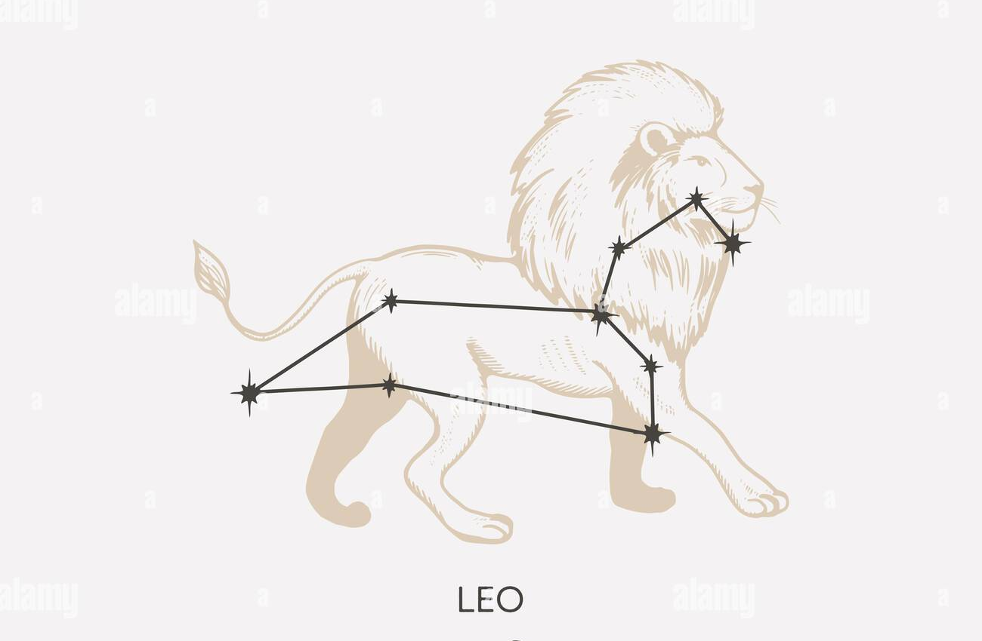
Leo
In Greek mythology, Leo represents the invincible Nemean Lion slain by Hercules in his first labor; its impenetrable skin made it a fearsome beast until Hercules strangled it and wore its pelt as armor.
Regulus, the bright heart of Leo, has been revered as a royal star since ancient Babylonian times.
Leo contains several notable stars and deep-sky objects, including five Messier galaxies and Wolf 359, one of the closest stars to Earth. It also hosts the Huge-LQG, the third largest known structure in the universe.
To locate Leo, first find the Big Dipper, then follow its pointer stars to Regulus. Leo’s sickle-shaped mane appears as a backward question mark in the eastern sky on April evenings.

Slide 12
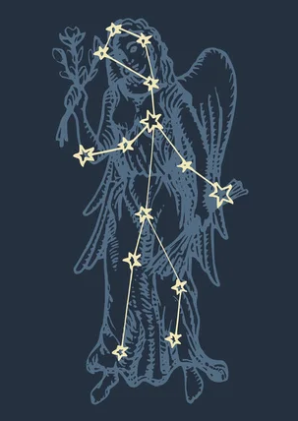
Virgo
Virgo, the second-largest constellation in the sky, is home to Spica, a brilliant blue giant and part of the Spring Triangle asterism.
Look for Spica shining below the arc of the Big Dipper’s handle in the southern sky during May.
Spica, meaning “ear of grain,” highlights Virgo’s deep ties to agriculture — a theme rooted in Babylonian and Greco-Roman mythology.
Virgo is rich in deep-sky objects, including the Virgo Cluster, Sombrero Galaxy, and M87.

Slide 13
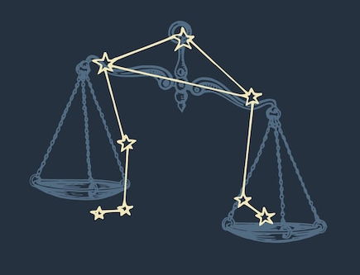
Libra
Libra is the only zodiac constellation that represents an object — the scales — symbolizing balance, justice, and law.
In ancient Greece, was the Astraea, the goddess of justice.
Its brightest stars still bear the legacy of their scorpion origins: Zubenelgenubi (“Southern Claw”) and Zubeneschamali (“Northern Claw”), the latter of which some observers see as faintly green.
Libra contains the red dwarf Gliese 581, which hosts several planets, including one in the habitable zone.
.
To find Libra in the night sky, look in June between the bright stars Spica (in Virgo) and Antares (in Scorpius); its stars form a wide, faint quadrilateral.

Slide 14
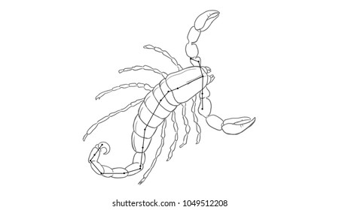
Scorpius
In Greek myth, it was sent to kill Orion, so the gods placed them apart — never seen in the sky at the same time, to keep them from fighting again.
Scorpius lies along the Milky Way and is rich in bright stars, star clusters (like M6 and M7), and deep-sky objects like the Butterfly and Cat’s Paw nebulae.
Across cultures, Scorpius has symbolized passion, danger, and rebirth, tied to its dramatic form and brilliant stars.
Scorpius is a stunning constellation shaped like a scorpion, anchored by the fiery red supergiant Antares at its heart.
Look low in the southern sky on summer nights—especially July—to spot its distinctive hook shape and glowing heart star, Antares.

Slide 15
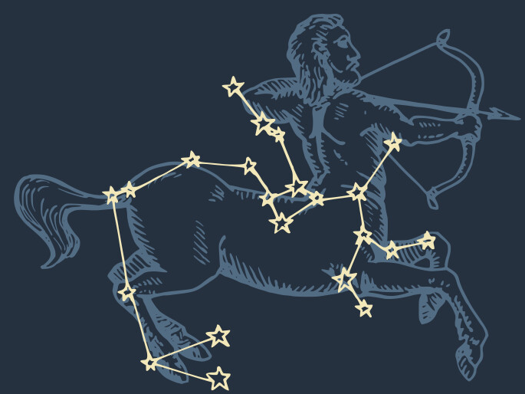
Sagittarius
It’s often linked to Chiron, the wise and noble centaur of Greek mythology, placed among the stars by Zeus.
The constellation lies in the direction of the Milky Way’s center and contains more Messier objects than any other, including the Lagoon, Trifid, and Omega nebulae.
Sagittarius hosts Sagittarius A, the supermassive black hole at the center of our galaxy, invisible but detected by powerful telescopes.
Sagittarius is symbolized by a centaur archer, aiming an arrow at the red heart of Scorpius, the star Antares.
Look south on August evenings for the “Teapot,” whose spout seems to pour steam into the Milky Way.

Slide 16
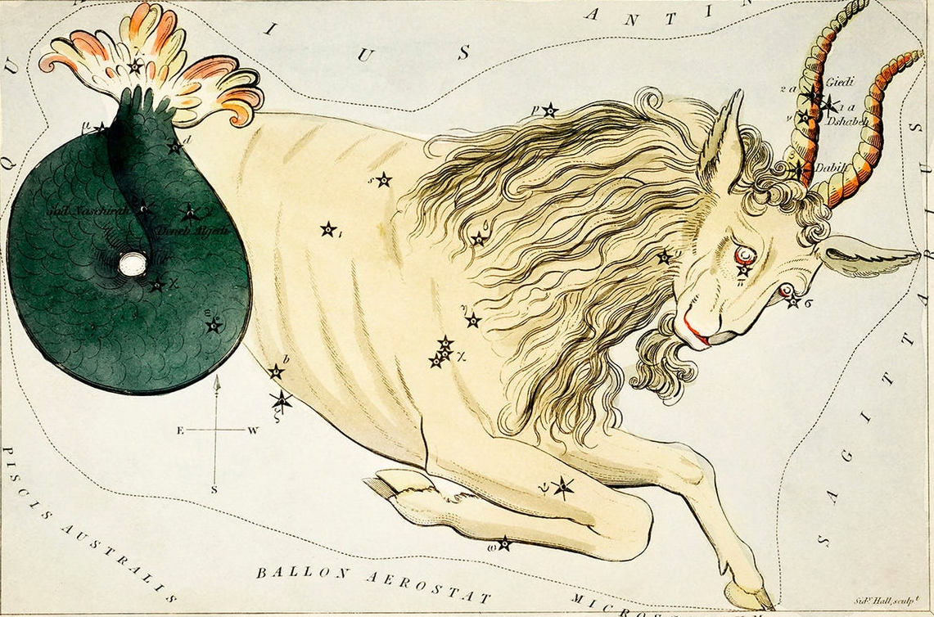
Capricornus
It depicts a sea-goat — a mythical creature with the head and upper body of a goat and the tail of a fish — symbolizing the union of earth and water, ambition and intuition.
The Sumerians associated Capricornus with Enki, their god of wisdom, water, and creation, while later Greek myths linked it to Pan, who transformed into a sea-goat to escape the monster Typhon.
Capricornus is the smallest and one of the faintest zodiac constellations.
To spot Capricornus, look for its faint, kite-shaped triangle low in the southern sky on early autumn evenings, nestled between Aquarius and Sagittarius.

Slide 17
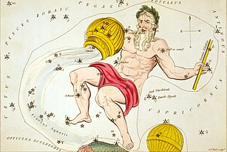
Aquarius
In Greek mythology, it represents Ganymede, a beautiful youth taken to Olympus by Zeus to serve as the divine cupbearer.
Its stars are faint and widely scattered, but include notable yellow supergiants like Sadalsuud (“luck of lucks”) and Sadalmelik (“luck of the king”).
The constellation’s annual reappearance was linked to flooding in cultures like the Egyptians, who saw it as the god Hapi measuring the Nile.
Best viewed under dark skies in October, Aquarius resembles a “water jar” pouring a stream of stars toward the Southern Fish.
Aquarius is a sprawling and ancient constellation long associated with seasonal rains and life-giving waters in many early civilizations.

Slide 18
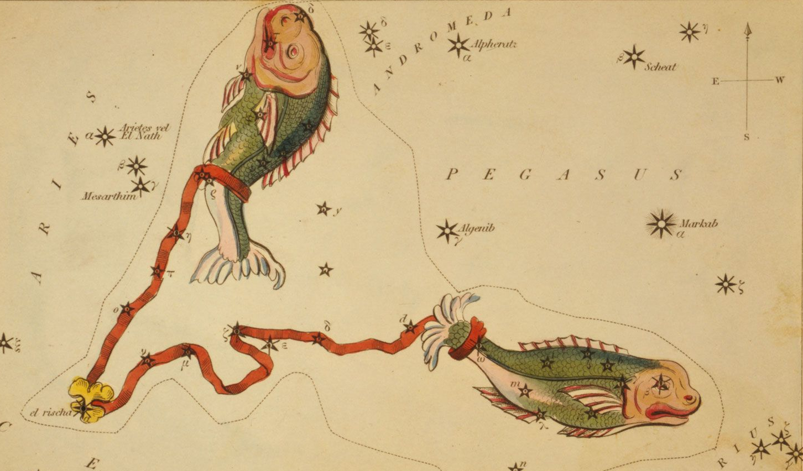
Pisces
Long associated with intuition and duality, Pisces also marks the current astrological age, believed to influence spiritual and cultural tides.
Despite its size, Pisces is composed of faint stars like Eta Piscium and Alrescha, requiring patience and dark skies to trace its graceful arc.
The constellation lies in the “Sea” region of the sky, home to other water-themed constellations, and hosts deep-sky wonders like the face-on spiral galaxy M74.
Look for a wide, faint “V” shape between Aquarius and Aries in November skies, with the Great Square of Pegasus helping to frame its western end.
Pisces represents two fish bound by a cord, a symbol drawn from myths of Aphrodite and Eros escaping the monster Typhon.

Slide 19
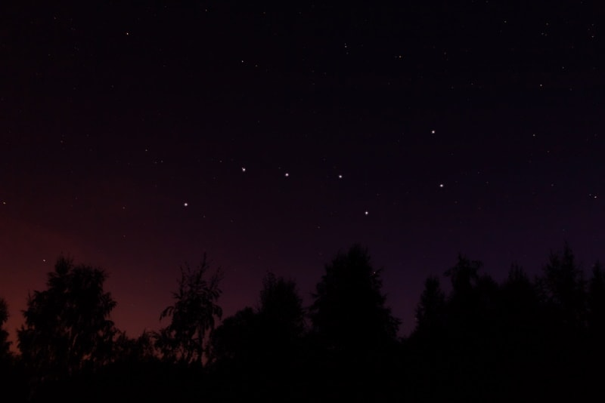
Asterism – Big dipper

Slide 20
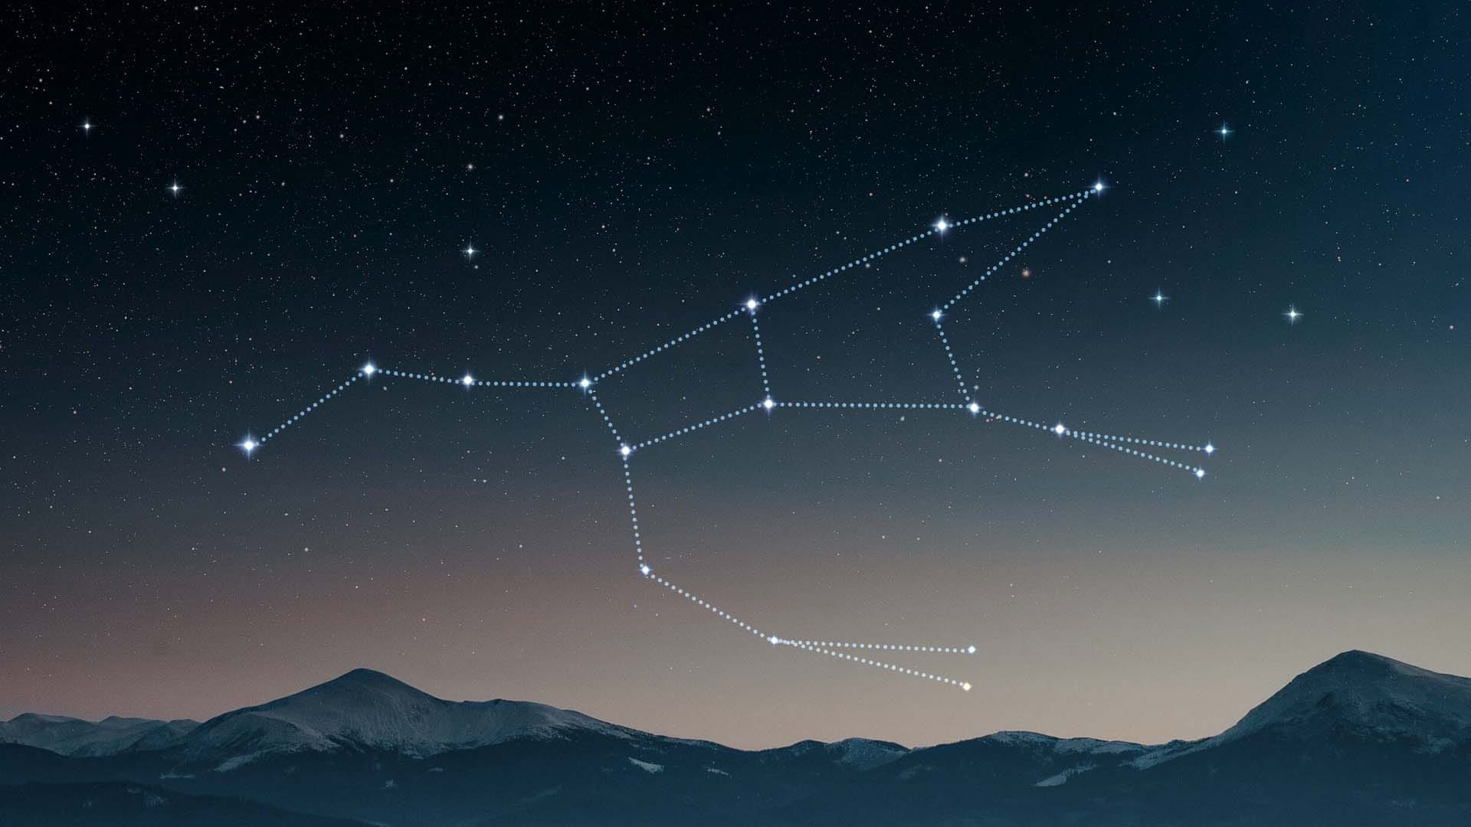
Constellation – Ursa Major

Slide 21
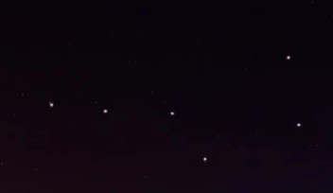
Asterism Vs Constellation
Asterism | Constellation
The Big dipper | Ursa Major
Informal Star pattern | Officially recognized by the IAU
Part of the constellation Ursa Major | Covers a large area of the northern sky

Slide 22
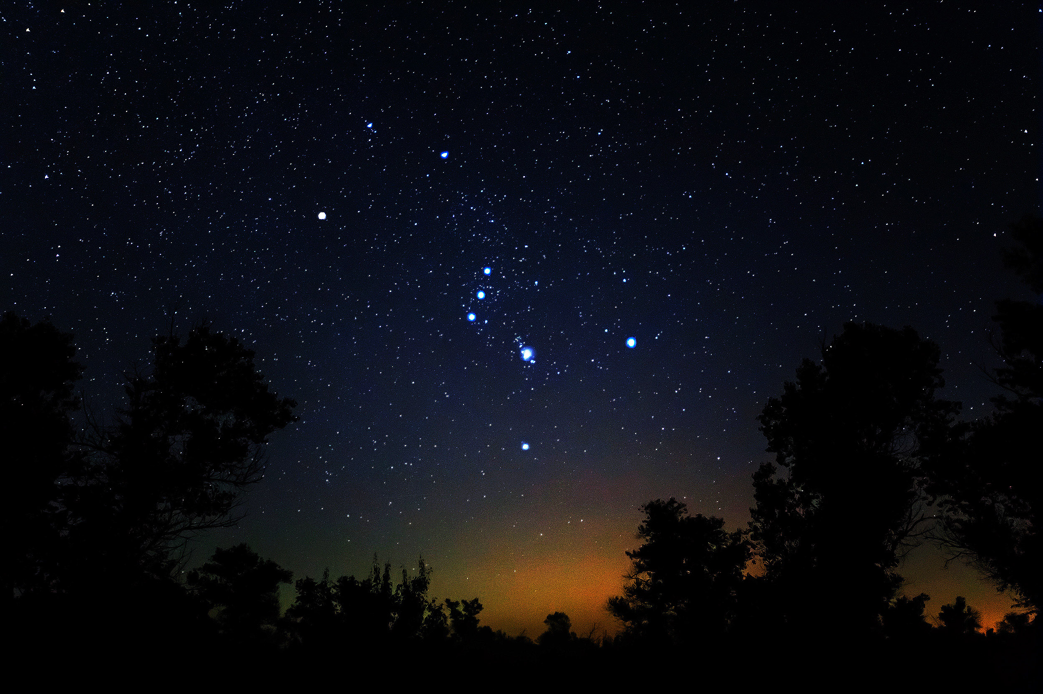
Orion Constellation

Slide 23
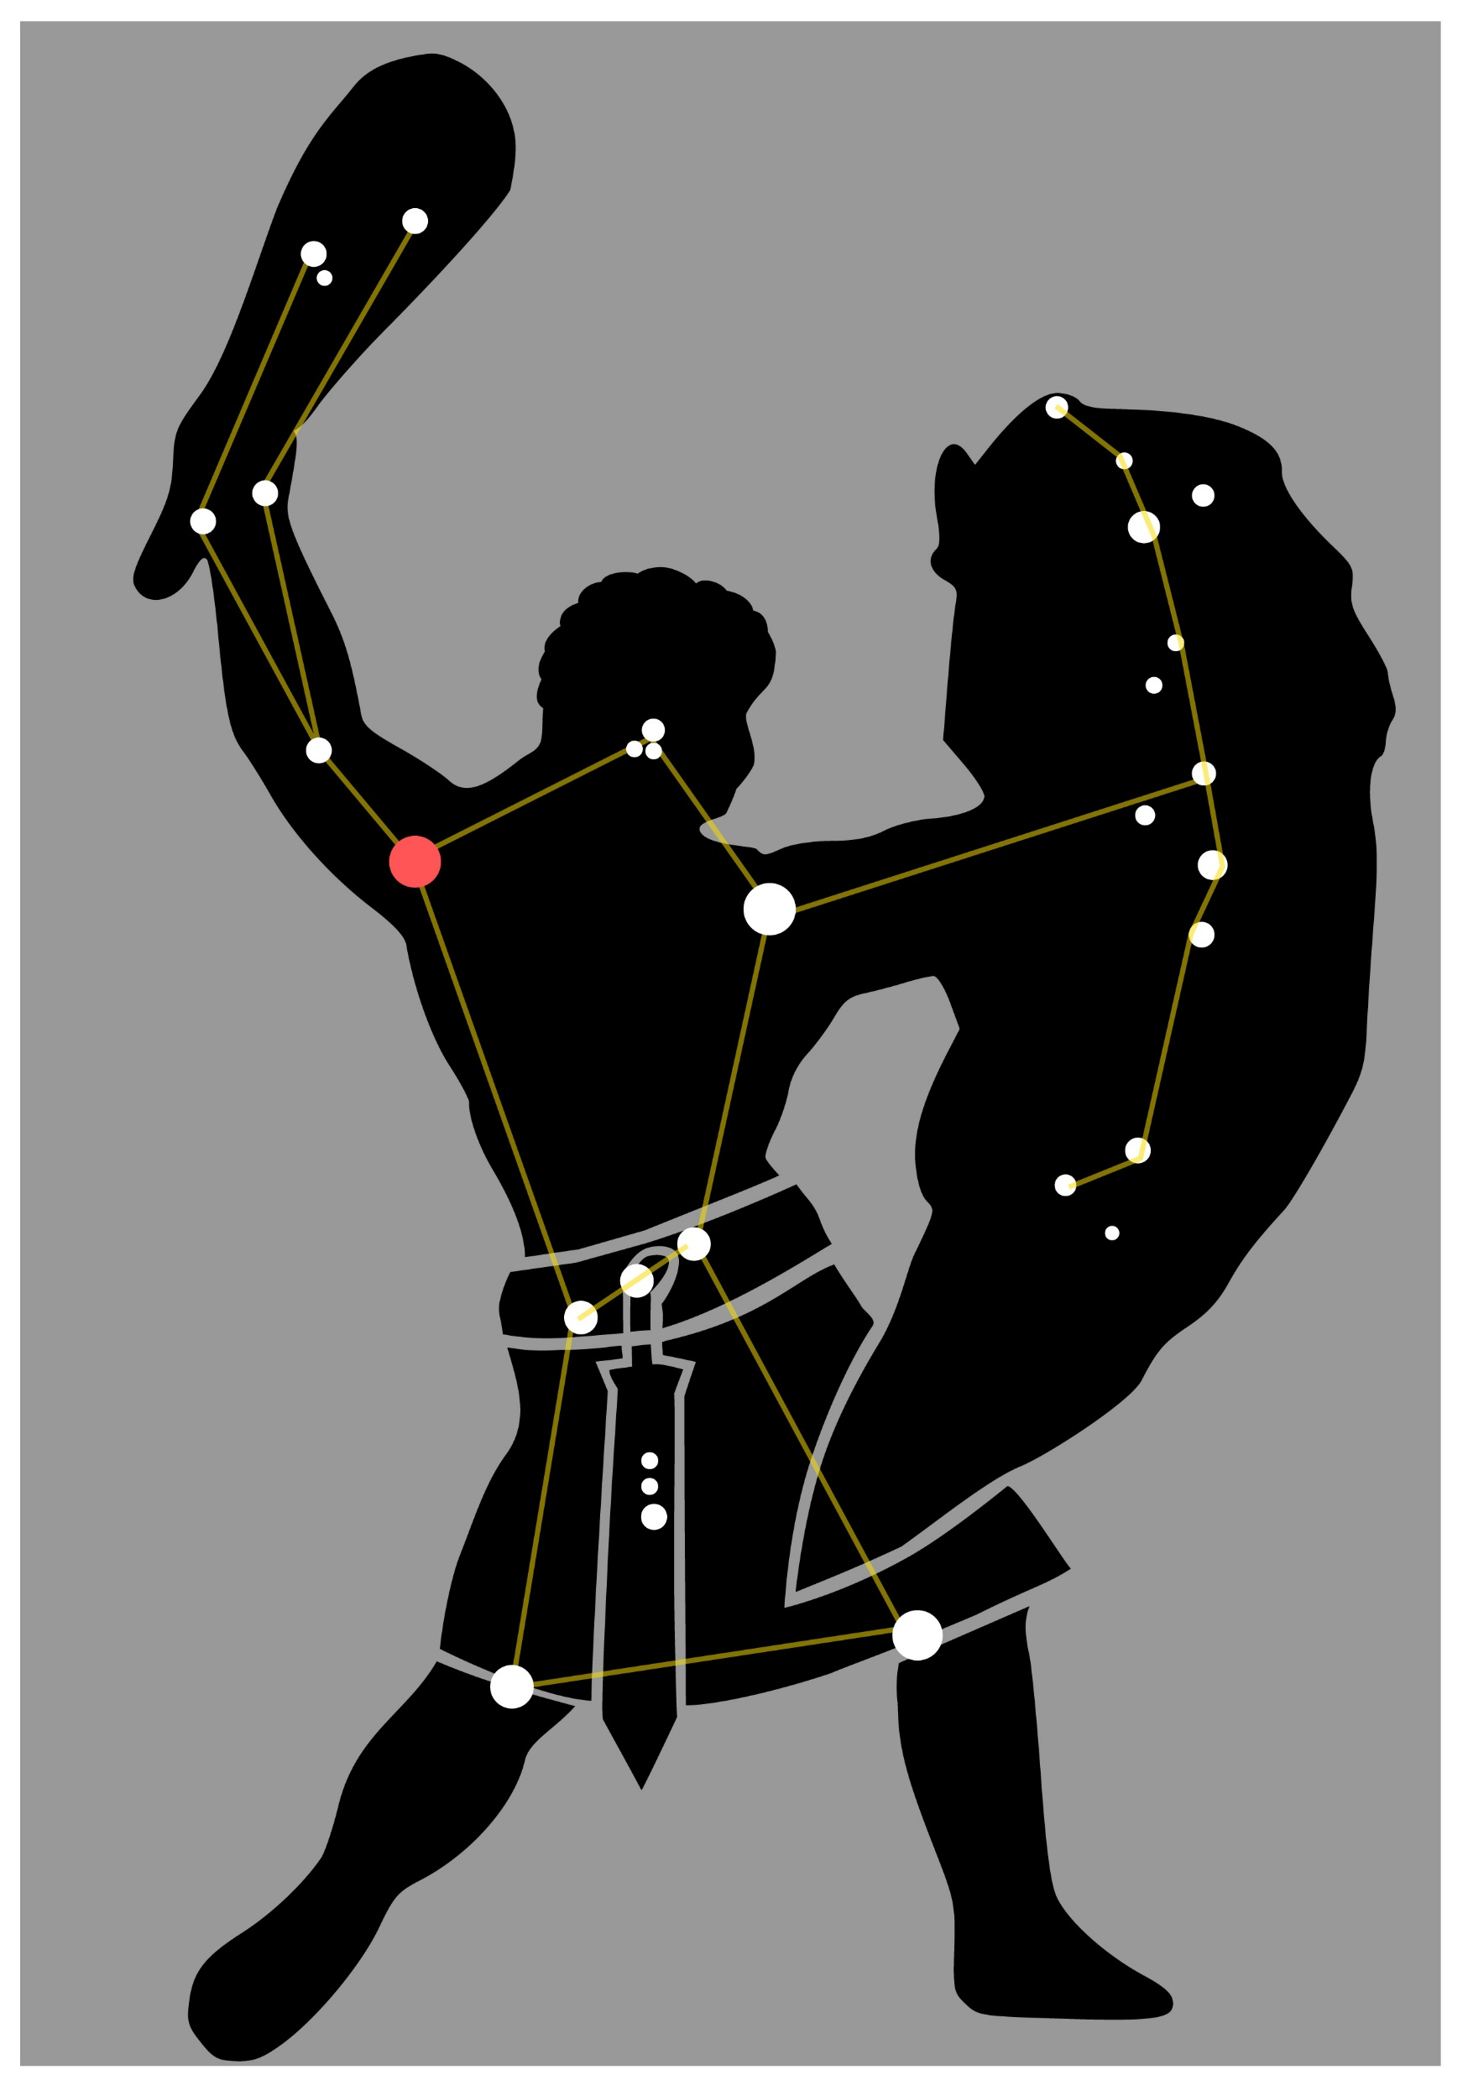
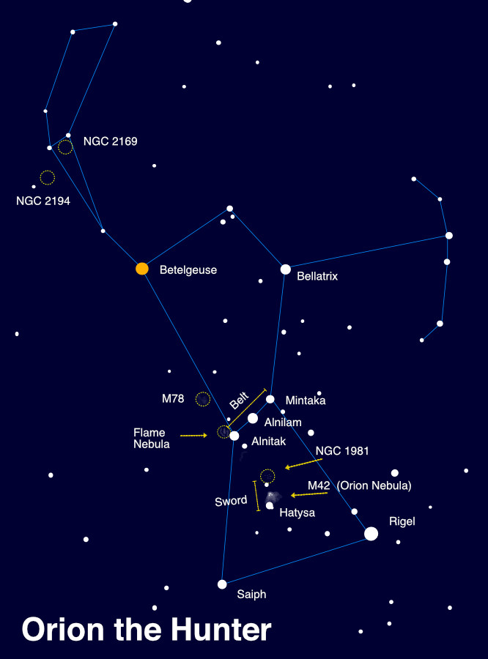
Orion Constellation

Slide 24
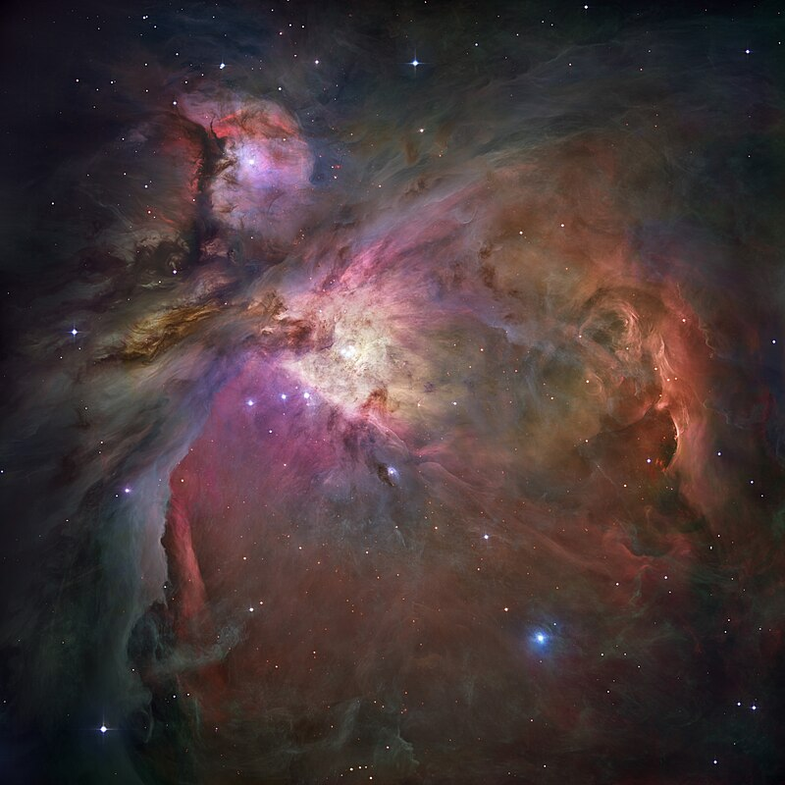
Orion Nebula – M42
Diffuse nebula
Right Ascension : 05^{h} 35^{m} 16.8^{s}
Declination : -05º 23’ 15”
Distance : 1,344 ± 20 ly

Slide 25
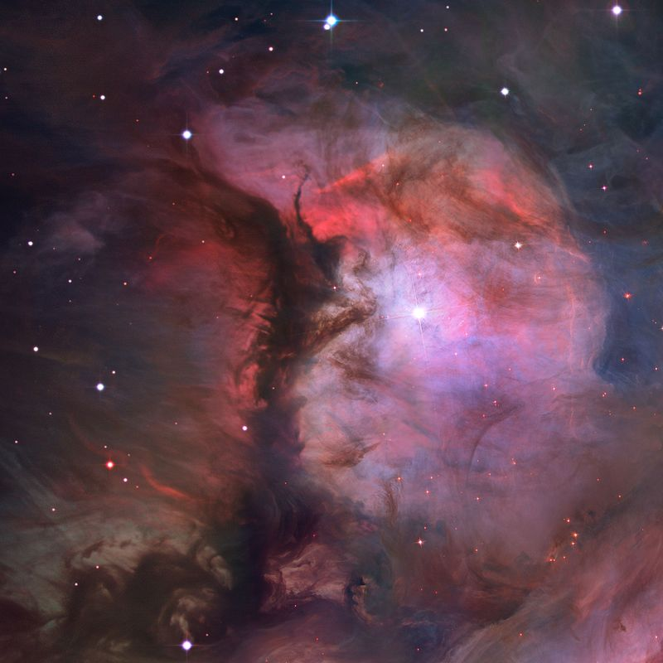
De Mairan's Nebula – M43
Emission nebula
Right Ascension : 05^{h} 35^{m} 31.8^{s}
Declination : -05º 17’ 57”
Distance : 1,300 ± 160 ly

Slide 26
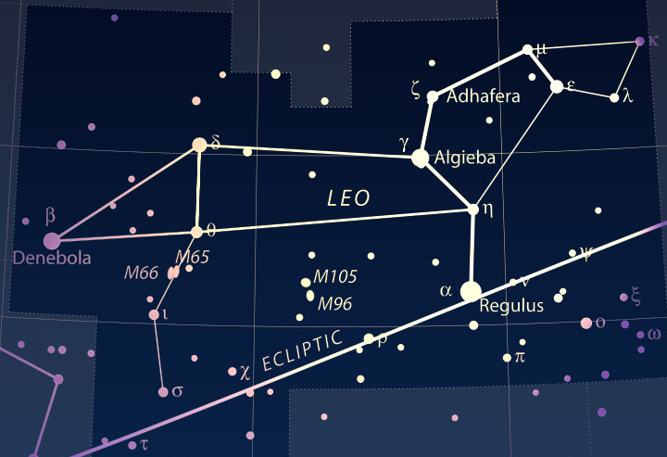
Leo Constellation
Leo Constellation

Slide 27
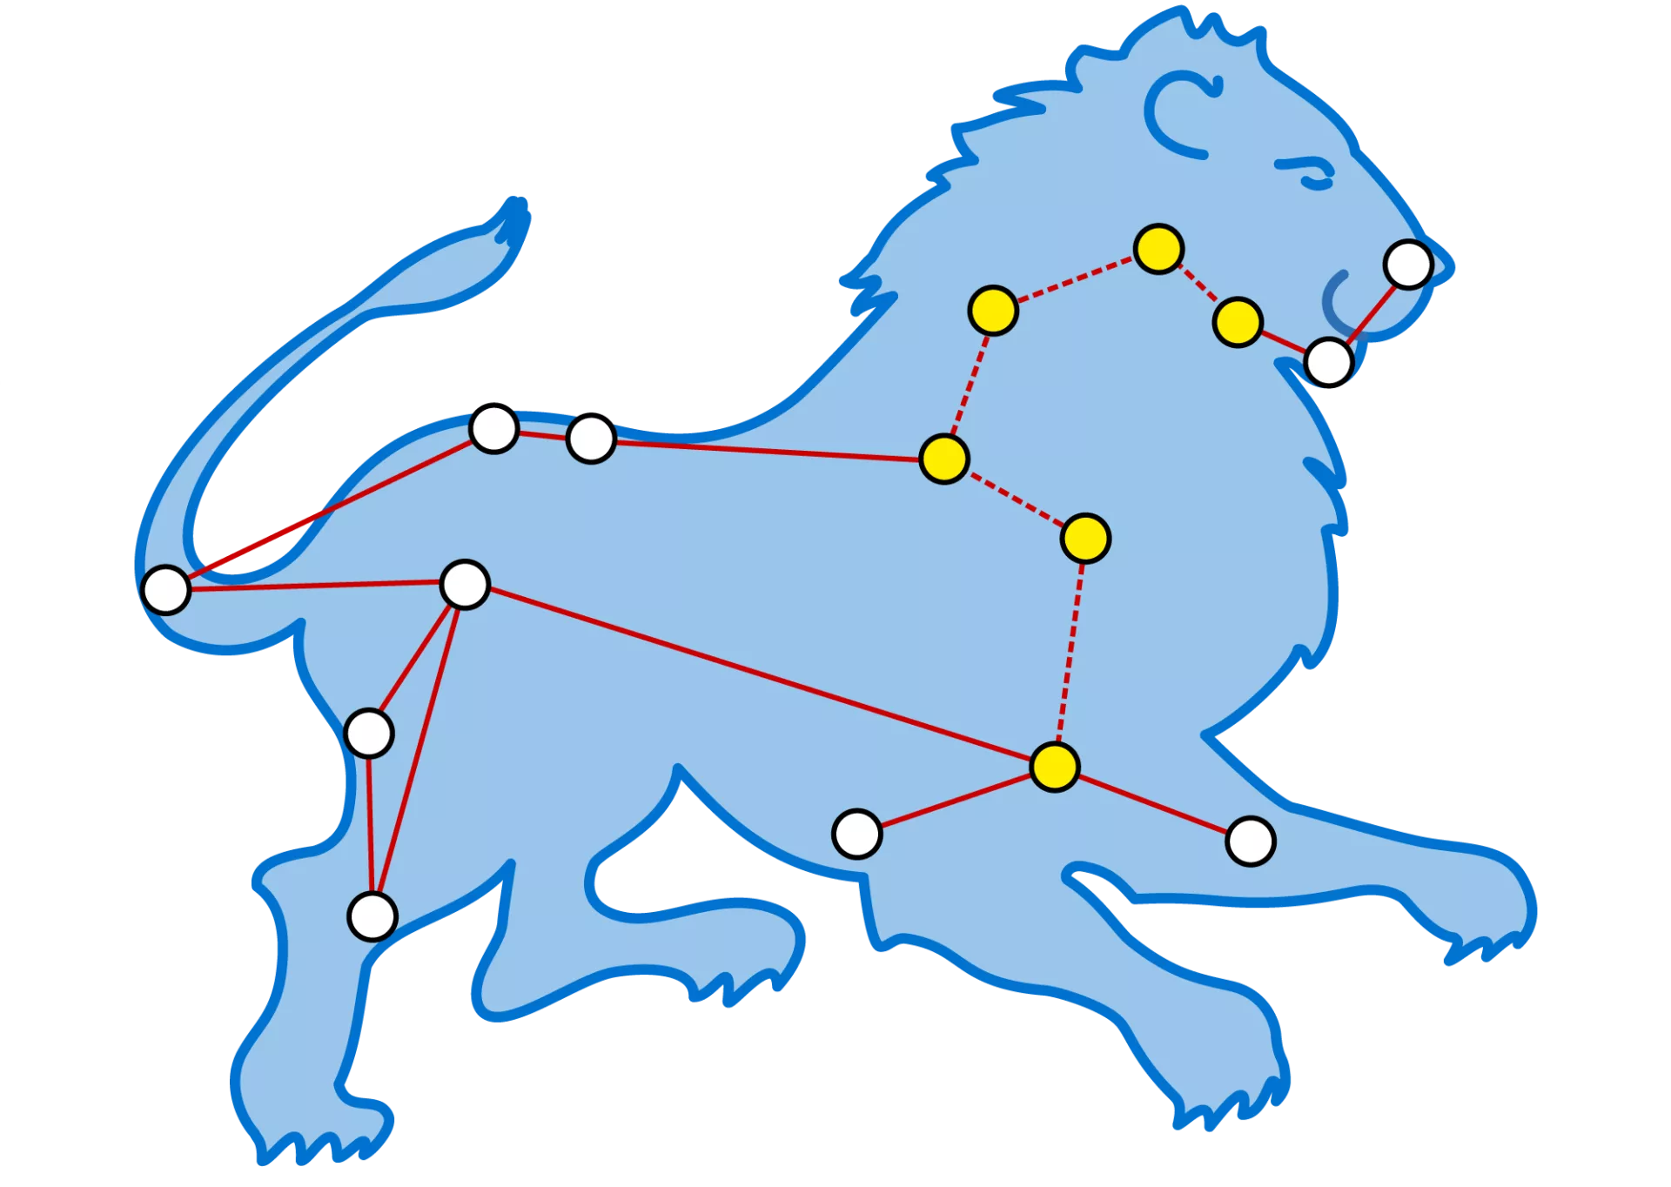
Leo Constellation

Slide 28
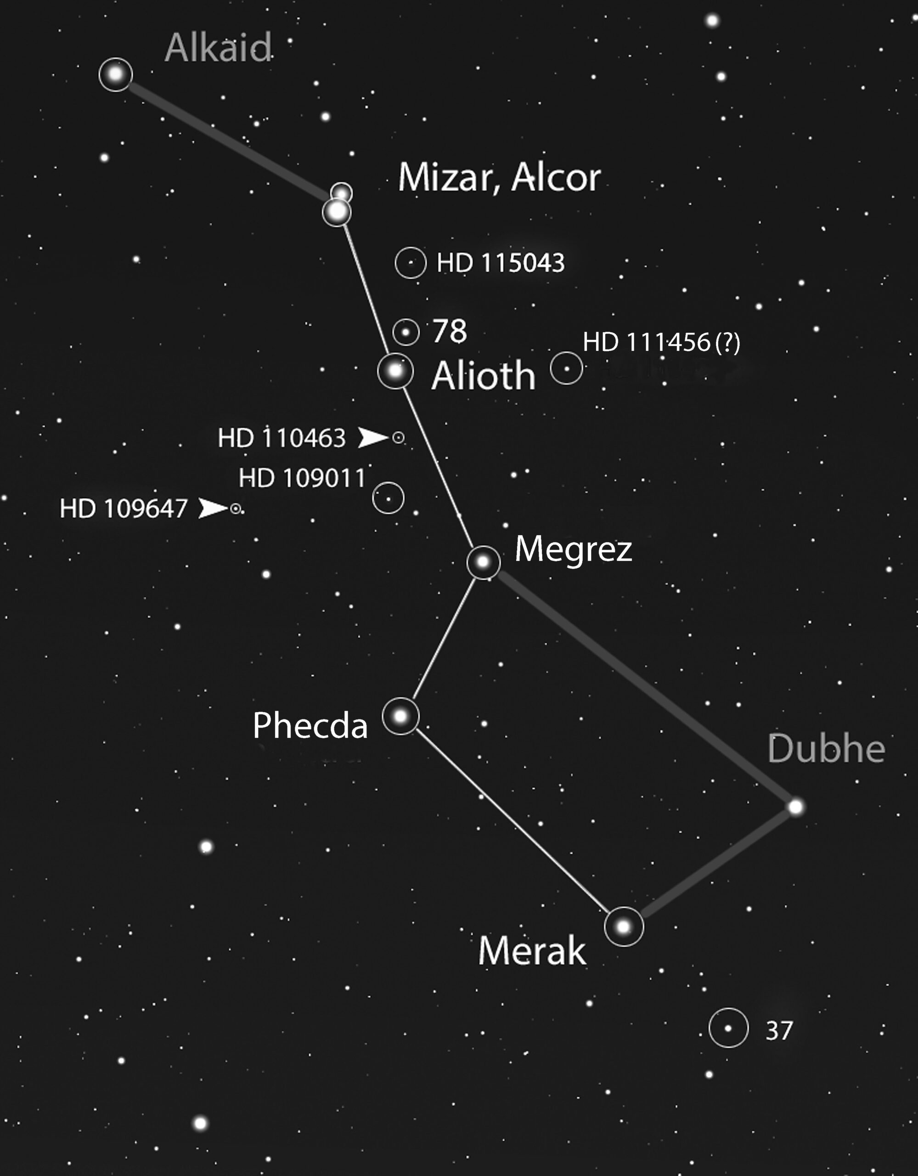
Big dipper

Slide 29
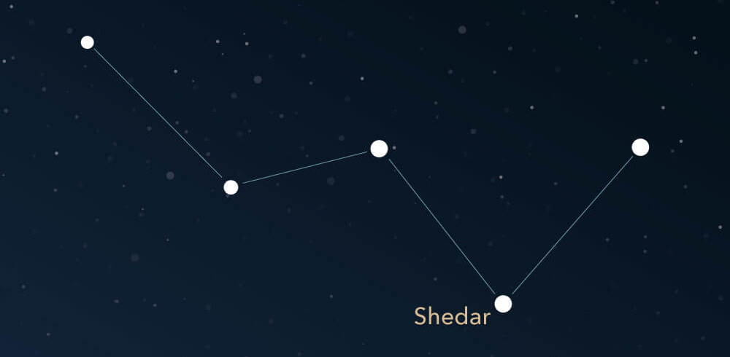
Cassiopeia

Slide 30
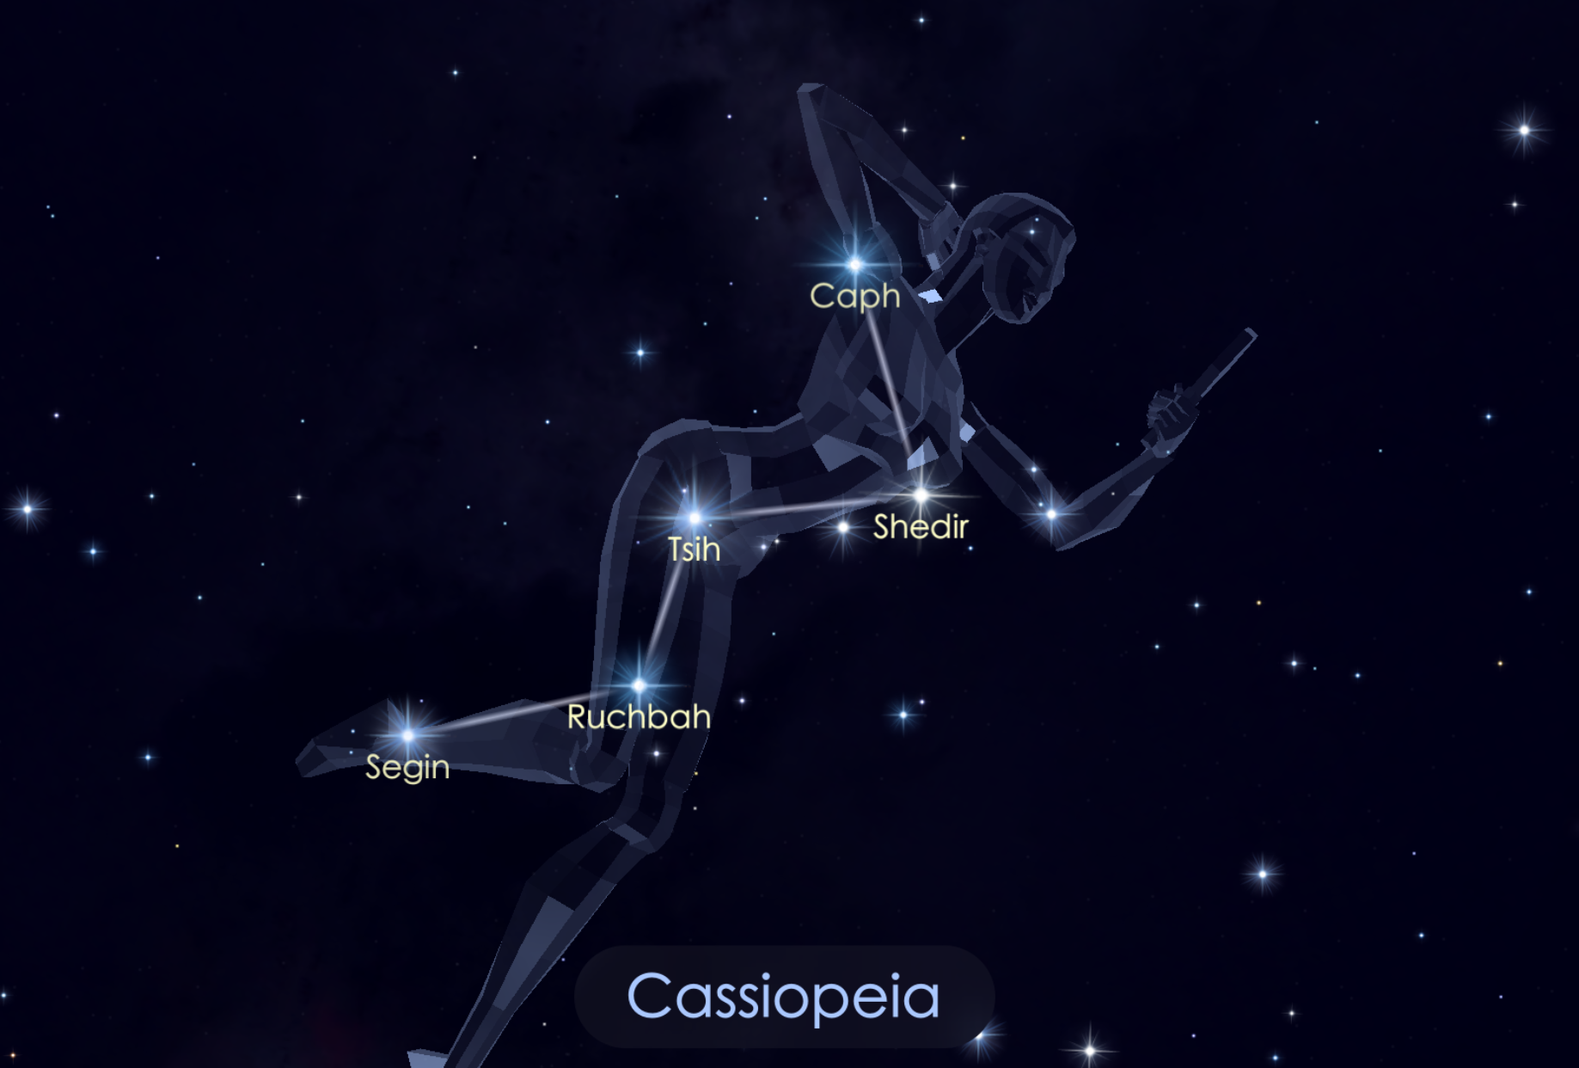
Cassiopeia – the Queen

Slide 31
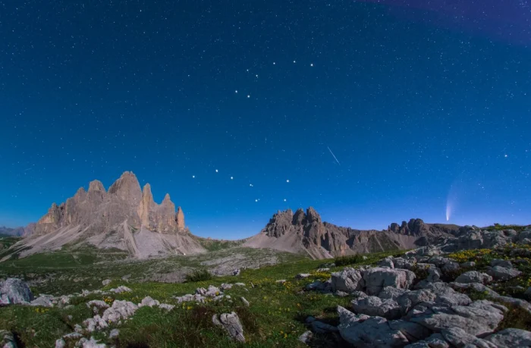
Big dipper and Little dipper

Slide 32
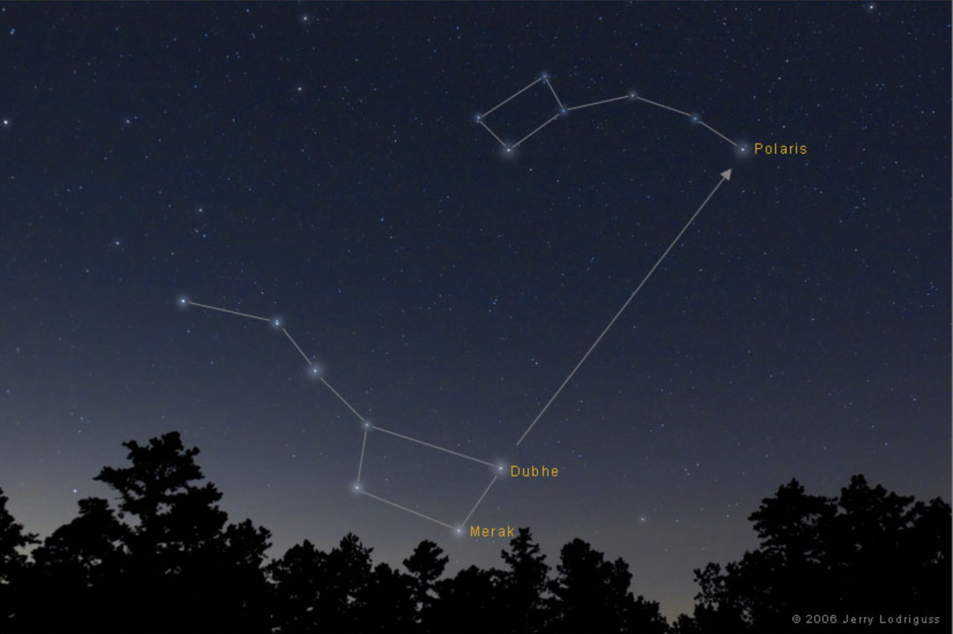
How to Locate Pole Star
Big dipper and Little dipper

Slide 33
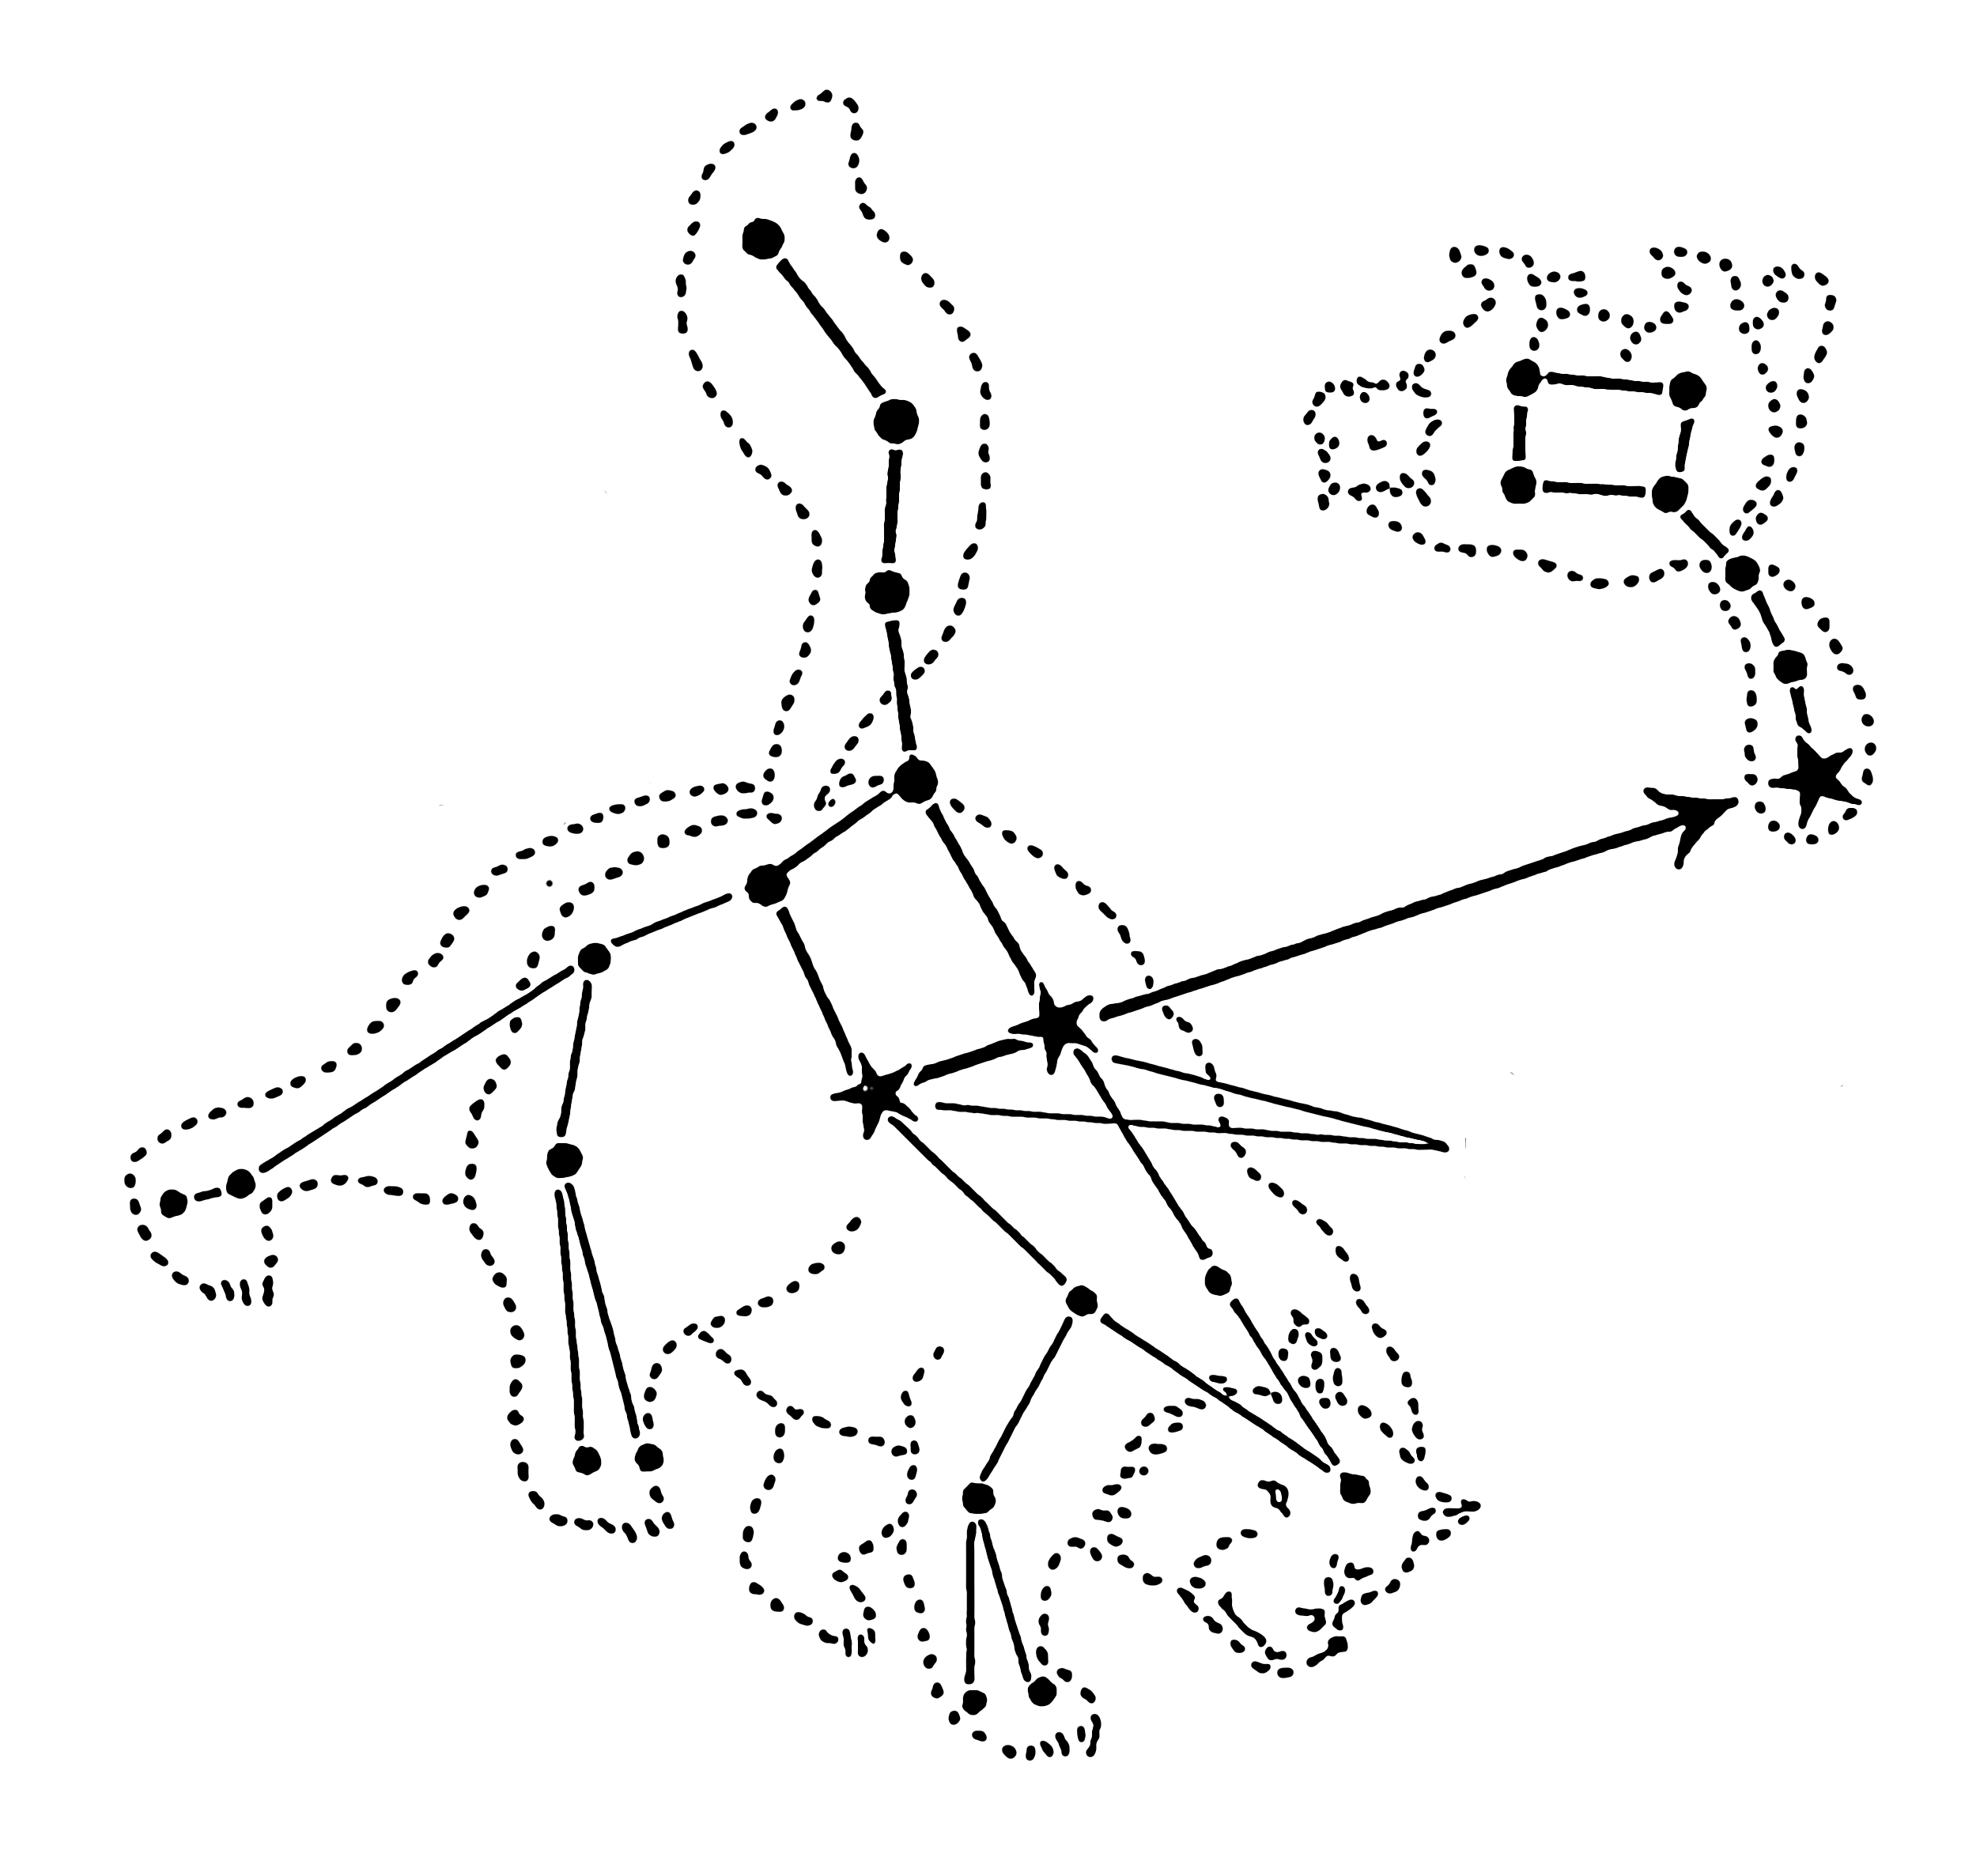
Big dipper and Little dipper

Slide 34
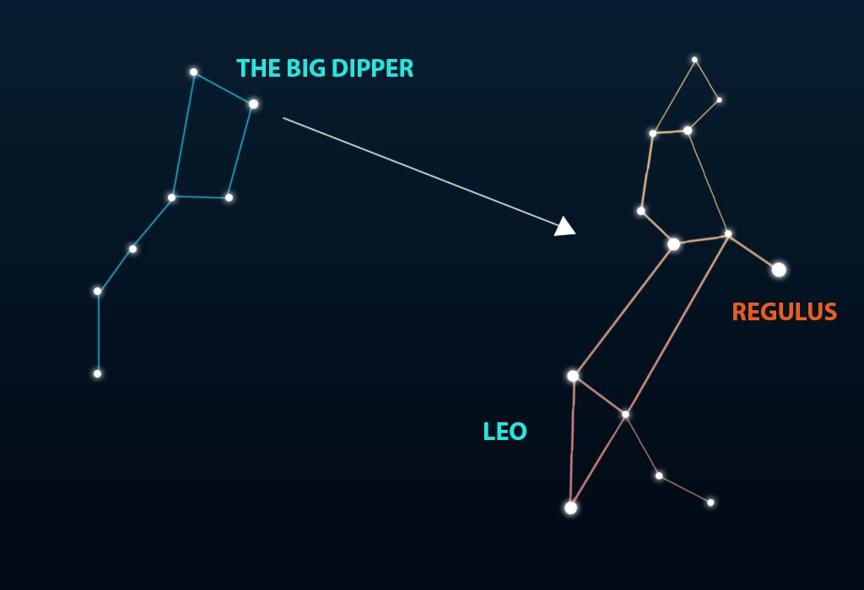
How to find Leo Constellation
Big dipper and Leo

Slide 35
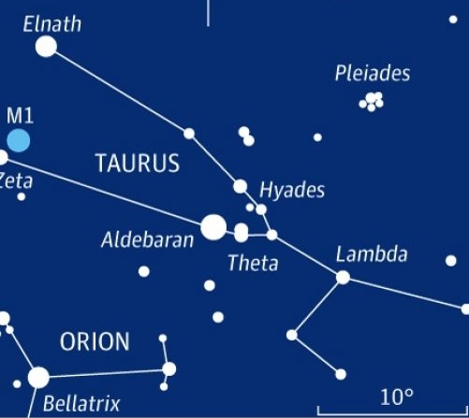
Taurus constellation

Slide 36
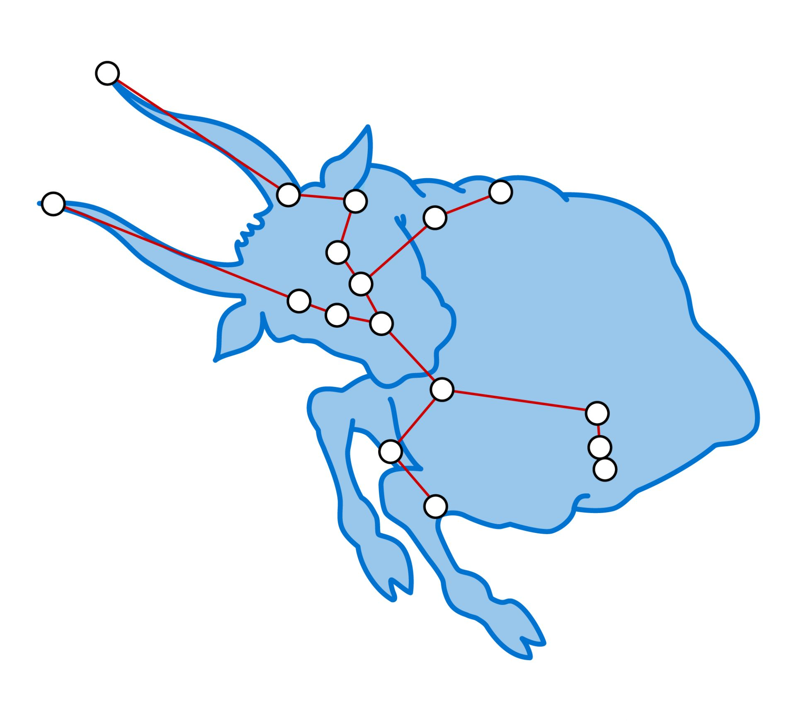
Taurus constellation

Slide 37
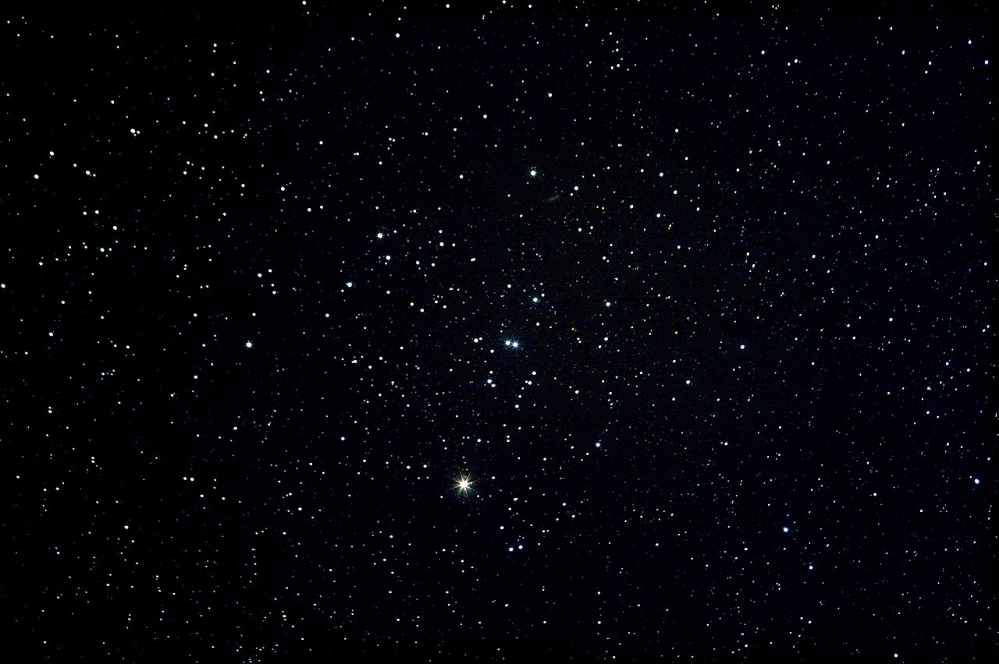
Hyades (star cluster)
Open Star Cluster
Right Ascension : 04^{h} 27^{m}
Declination : +15º 52’
Distance : 153 ly

Slide 38
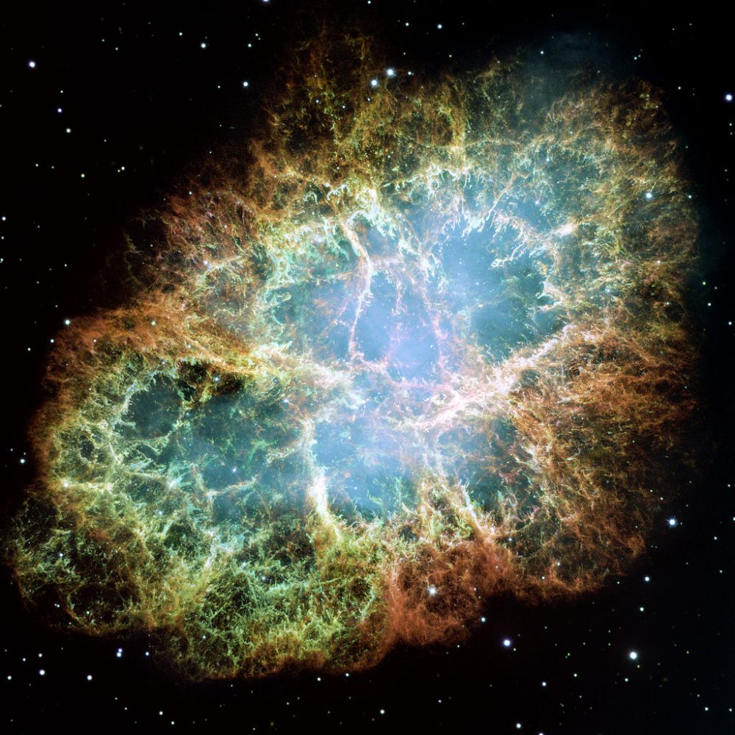
M1 – the Crab Nebula
Supernova Remnant and pulsar wind nebula
Right Ascension : 05^{h} 34^{m} 31.8^{s}
Declination : +22º 01’ 03”
Distance : 6,500 ± 1,600 ly

Slide 39
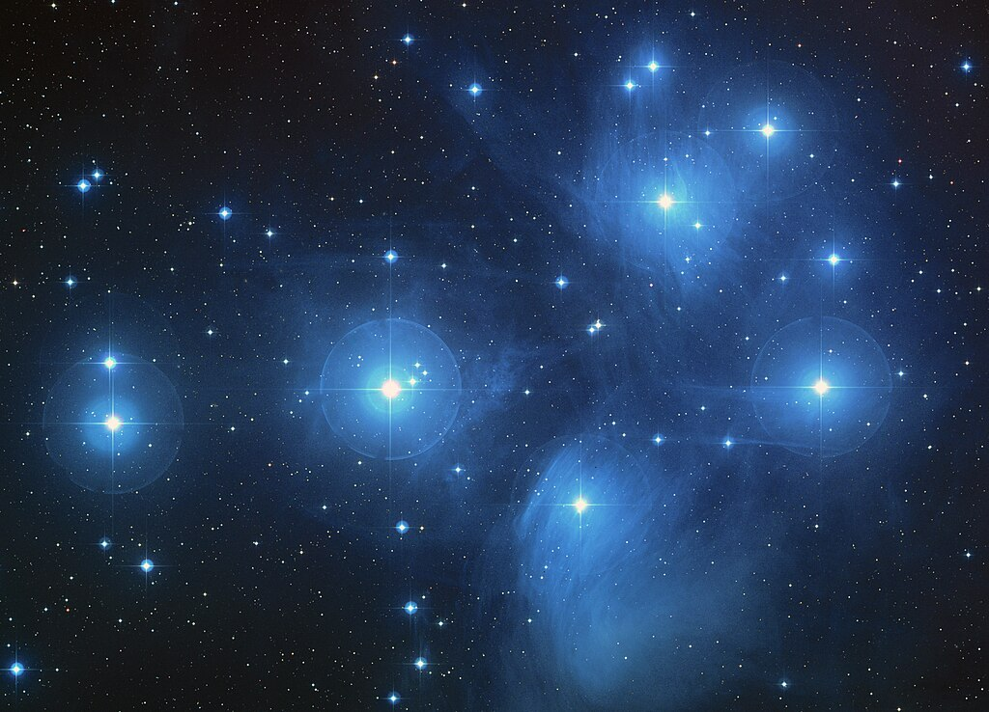
M45 – Pleiades
Open Star Cluster
Right Ascension : 03^{h} 47^{m} 24^{s}
Declination : +24º 07’ 00”
Distance : 444 ly

Slide 40
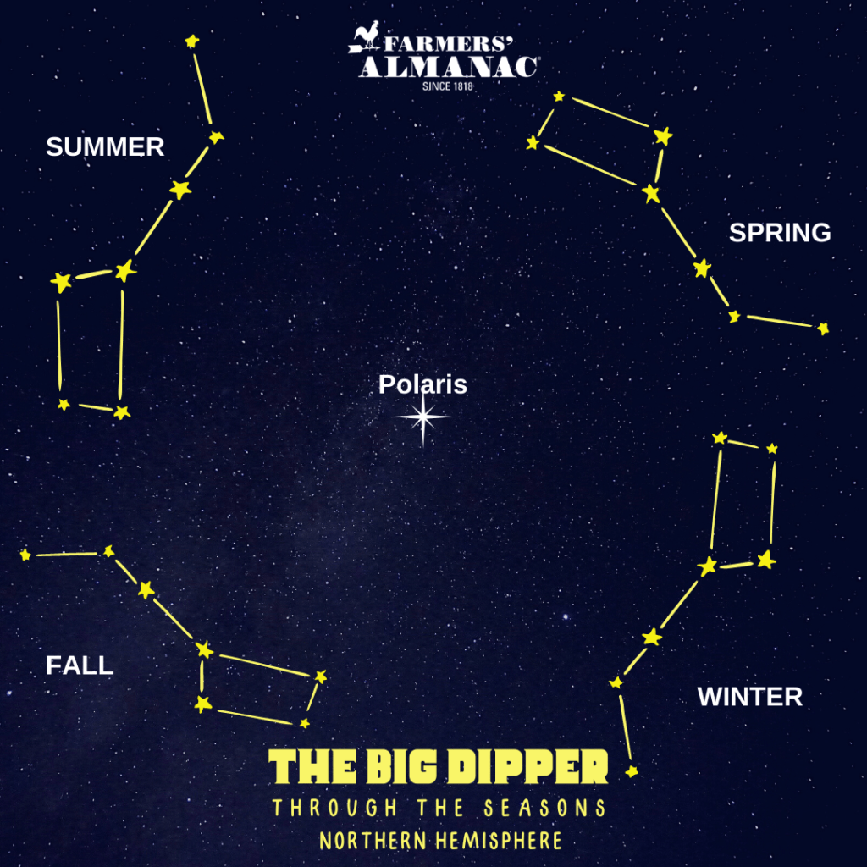

Slide 41
Star Clusters
Star Clusters
Two types of star clusters :
Open star clusters (also called galactic clusters) :
- loosely arranged groups of stars, occasionally not too distinctive from the background stars
e.g. M36, M37, M38
2) Globular star clusters :
- tightly packed groups of many millions of stars.
e.g. M3 in Canes Venatici

Slide 42
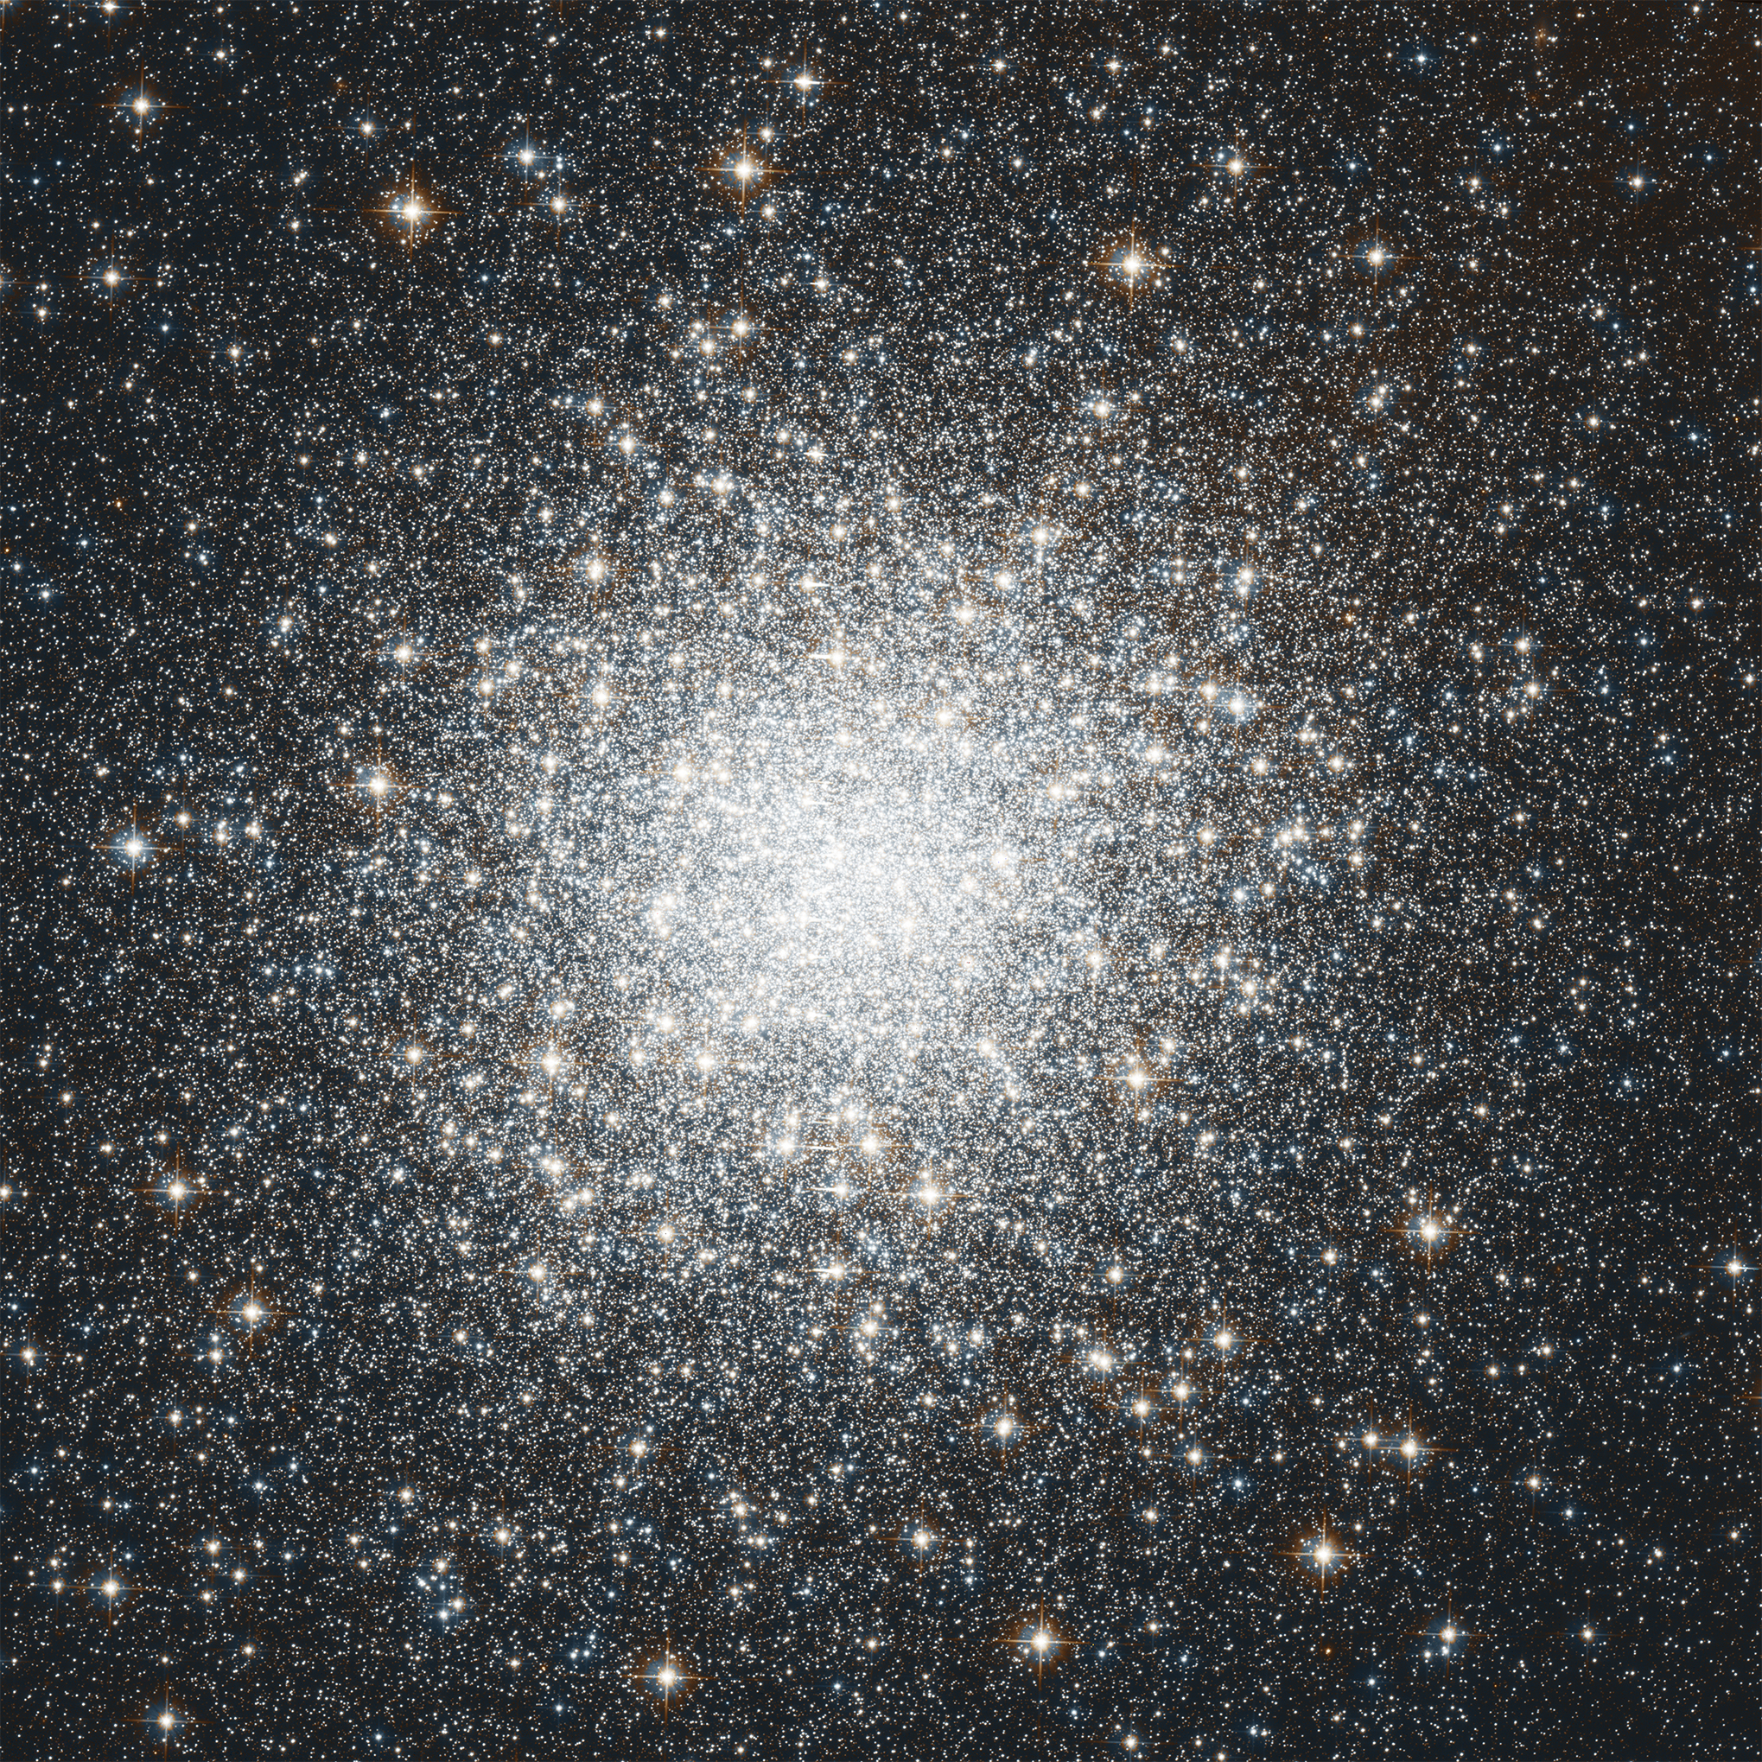
M2 - in Aquarius Constellation
Globular Star Cluster
Location : Aquarius constellation
Right Ascension : 21^{h} 33^{m} 27.02^{s}
Declination : 00º 49’ 23.7”
Distance : 55,000 ly
Diameter : over 150 light-years
Star Strength : over 1,50,000 stars

Slide 43
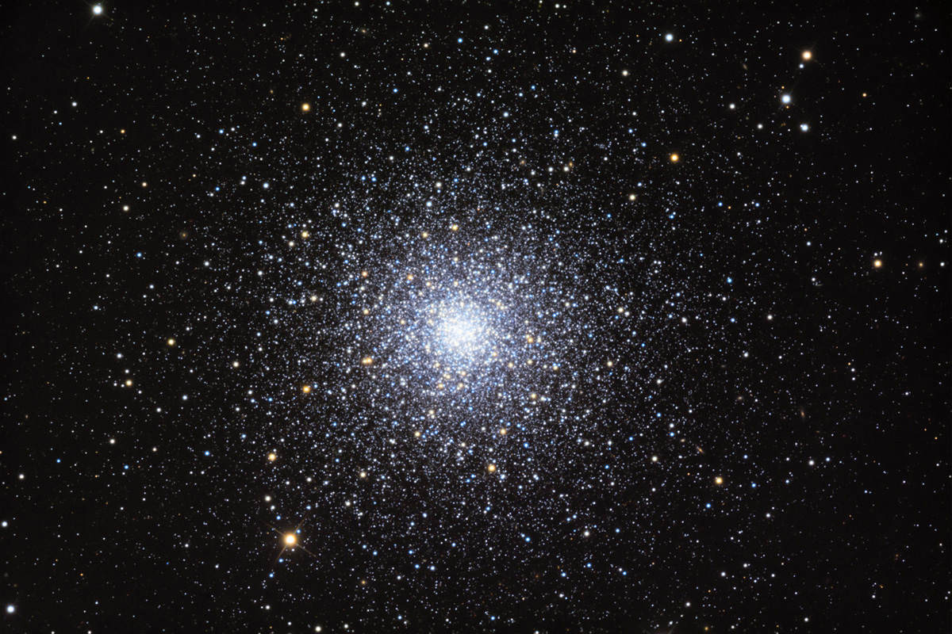
Star Clusters - Globular
M3 - in Canes Venatici Constellation
Globular Star Cluster
Location : Canes Venatici constellation
Right Ascension : 13^{h} 42^{m} 11.62^{s}
Declination : +28º 22’ 38.2”
Distance : 33.9 kly
Star Strength : over 5,00,000 stars
M3 contains at least 274 variable stars

Slide 44
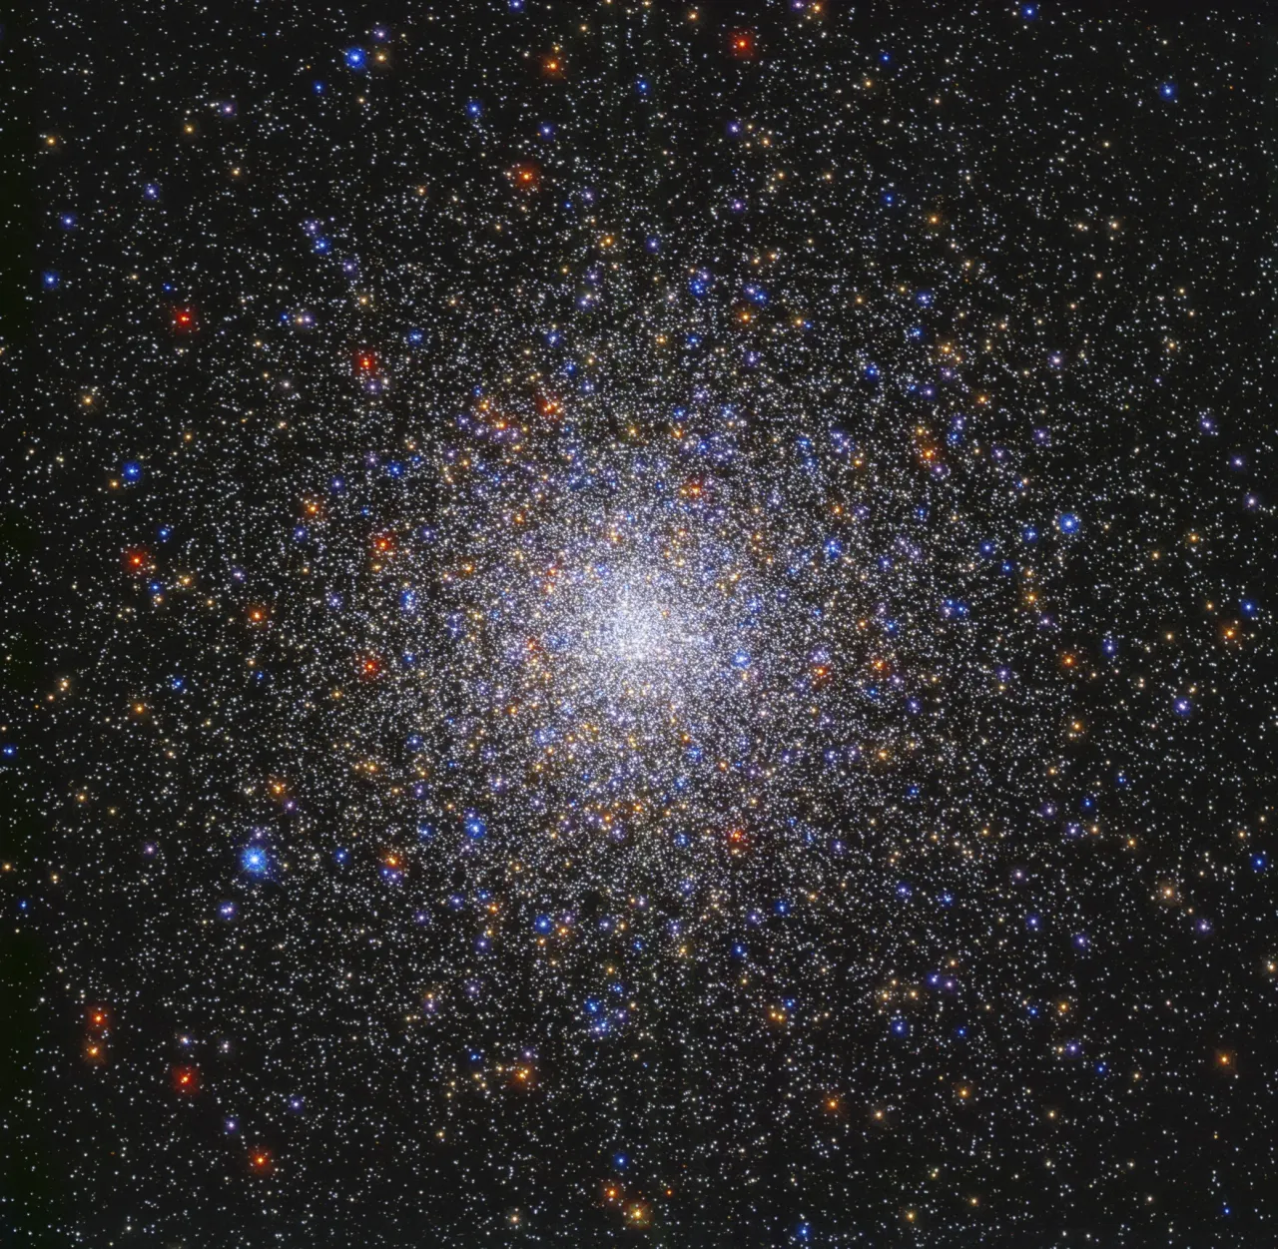
M80 - in Scorpius Constellation
Globular Star Cluster
Location : Scorpius Constellation
Right Ascension : 16^{h} 17^{m} 02.41^{s}
Declination : 22º 58’ 33.9”
Distance : 32.6 kly

Slide 45
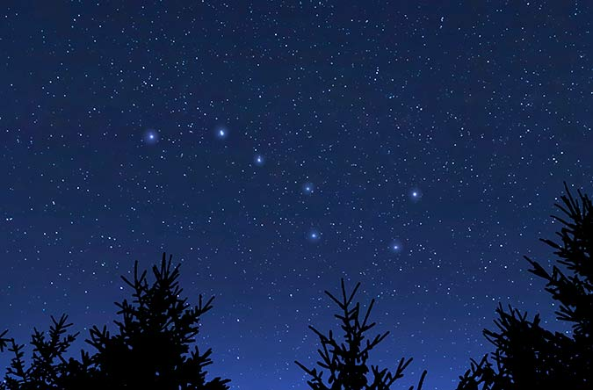
Binary Star – Alcor and Mizar

Slide 46
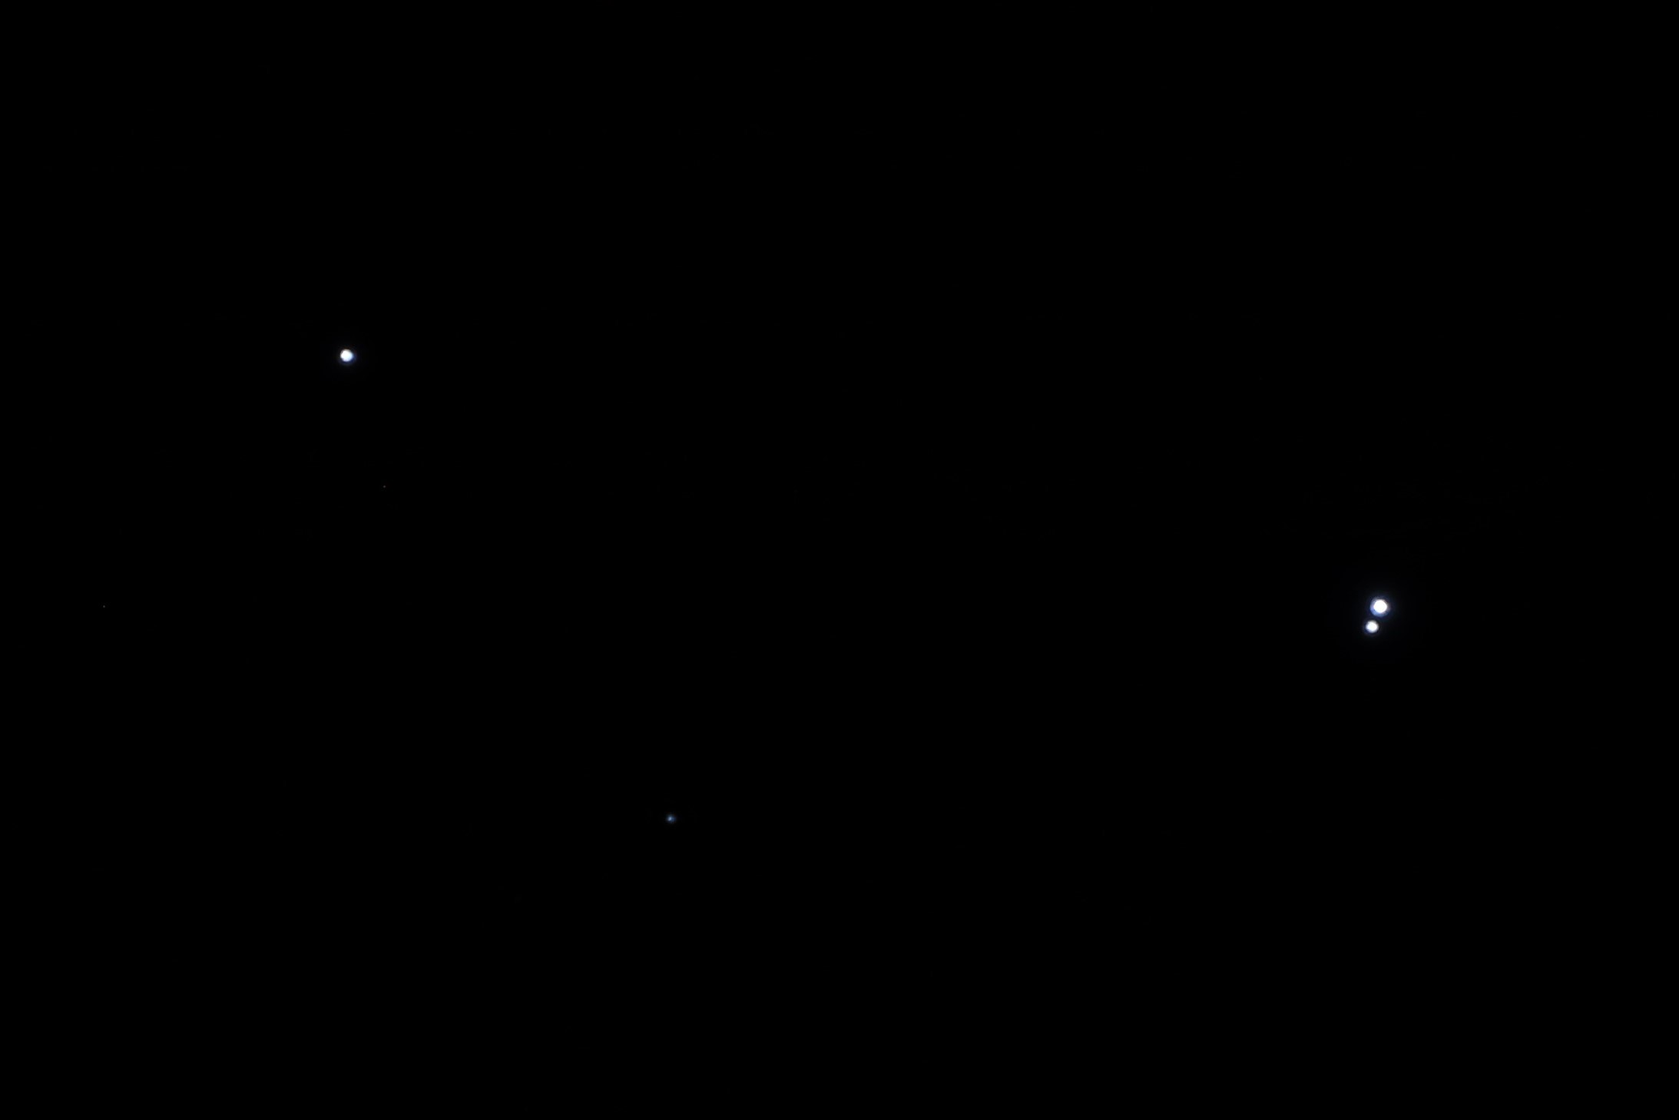
Binary Star – Alcor and Mizar

Slide 47
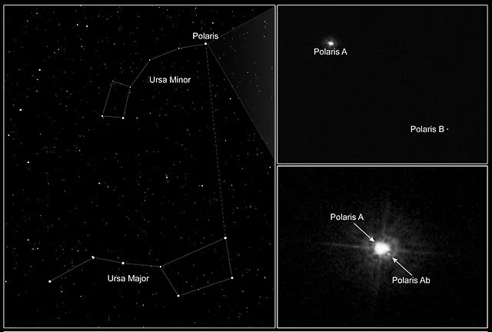
Polaris – Tristar system as seen from HST

Slide 48
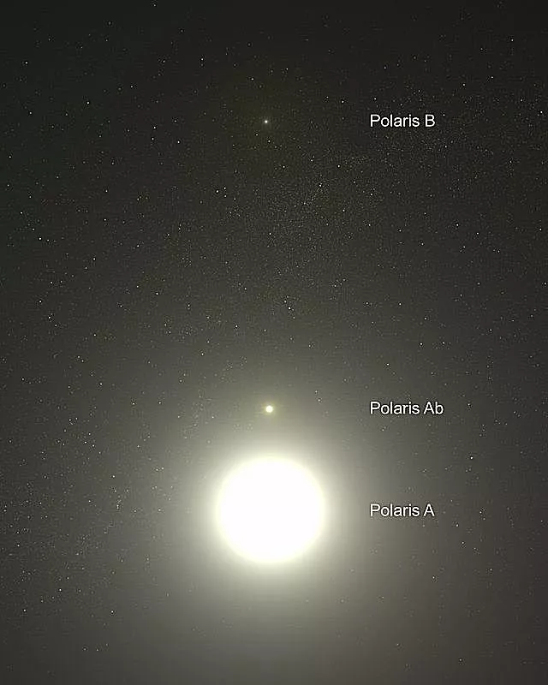
Polaris – Tristar system
Distance - 446 light-years

Slide 49
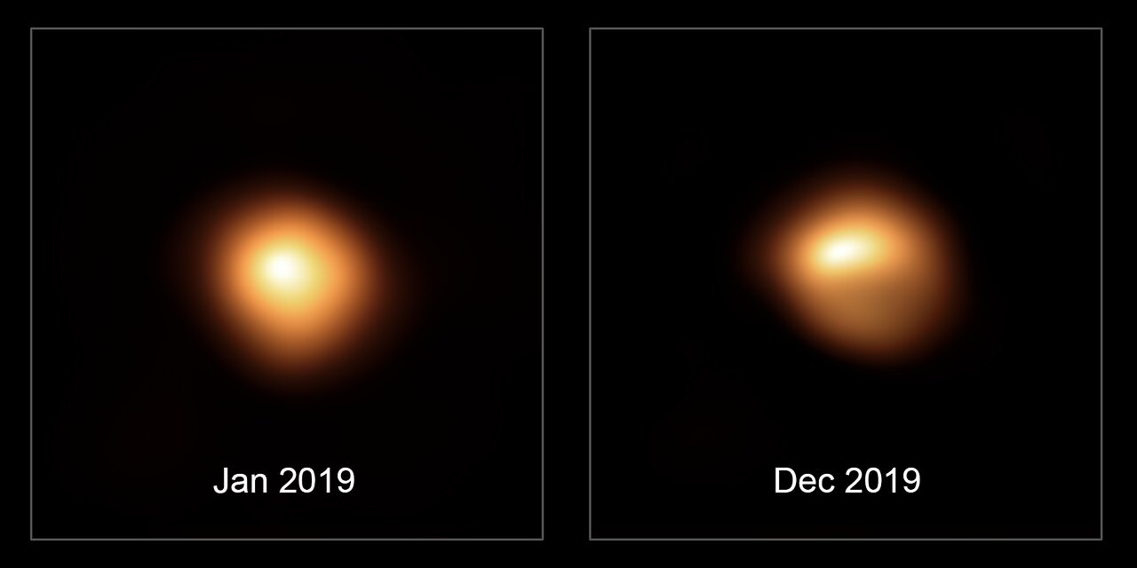
Variable Stars
Variable Stars
Varying their brightness
Eg. Betelgeuse

Slide 50
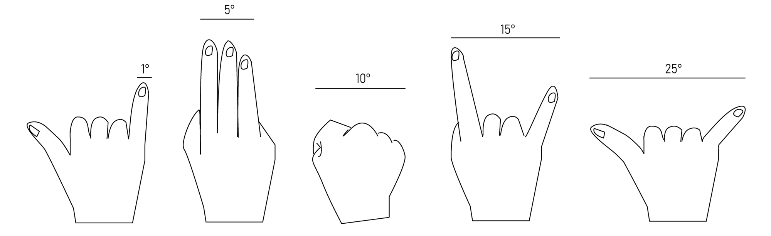
Measuring Distances In The Sky With Your Hands
Measuring distances in the sky

Slide 51
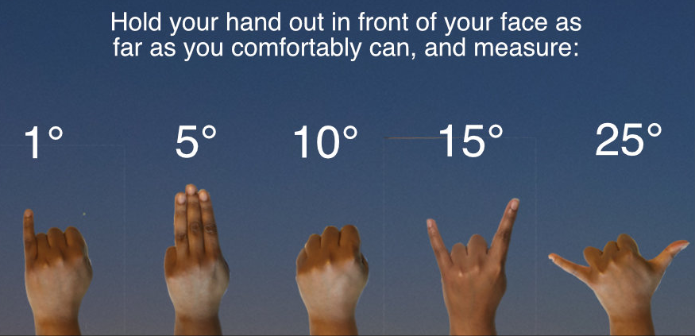
Handy Sky Measurements
Measuring distances in the sky

Slide 52
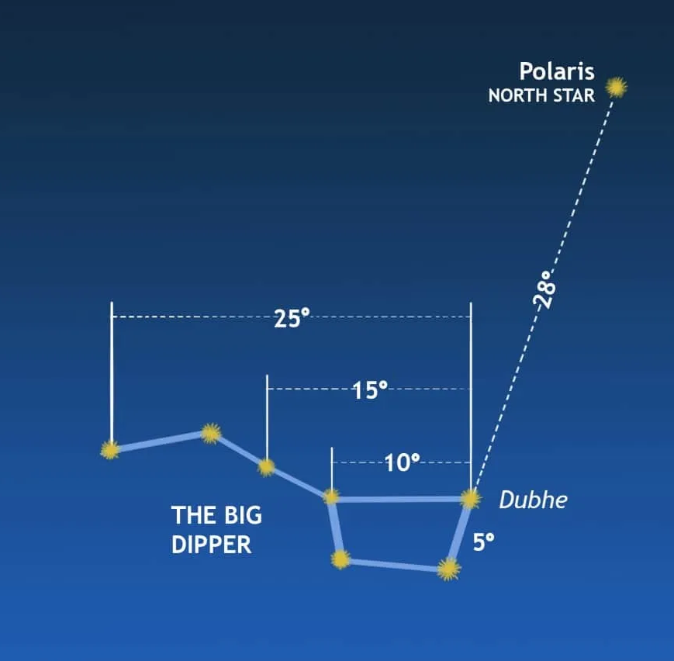

Measurement of the Sky with the Big Dipper
Measuring distances in the sky with Big dipper

Slide 53

Distances to the Stars of Orion in the sky

Slide 54

The Naked Eye Sky Chart

Slide 55

The Naked Eye Sky Chart

Slide 56

The Naked Eye Sky Chart

Slide 57
Thank You

